Slide 1
Timekeeping and Customer Satisfactions
Supervisor
Kiều Trọng Khánh
Member
Lê Thanh Tân – SE61244 (Leader)
Nguyễn Năng Trung – SE61080
Thái Quang Hiển – SE60896

Slide 2
Overview
Introduction
Customer Service Problem
Our Proposal
Timekeeping Problem
Our Proposal
Advantage / Disadvantage
Future plan

Slide 3

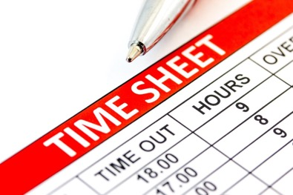
Introduction
1. Customer Emotion
2. Timekeeping
Notes:
Thể hiện ý nghĩa 2 phần rõ ràng

Slide 4
Customer Emotion
Problem
Scenario
Mr.Sang wants to apply for a visa credit card

Slide 5
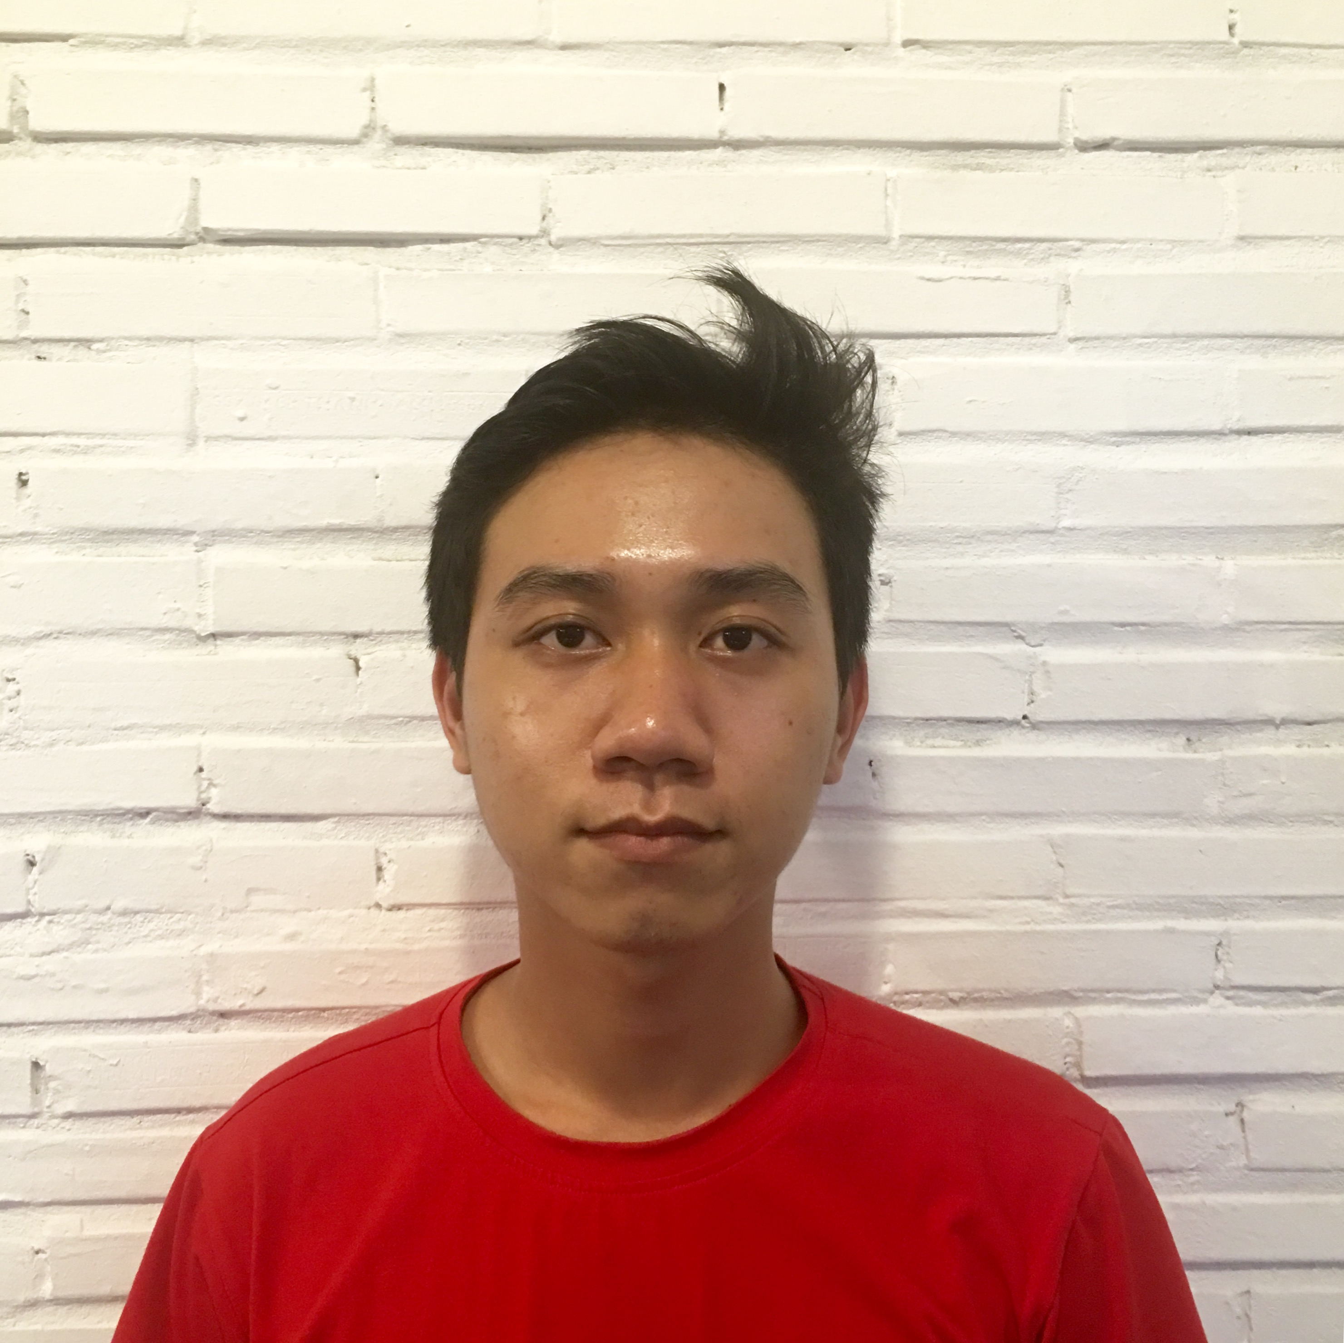

Customer Emotion
Problem
Scenario
Mr.Sang wants to apply for a visa credit card
1. Go to bank
Mr. Sang (Customer)

Slide 6
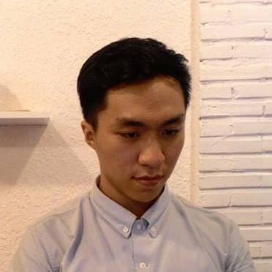
Customer Emotion
Problem
Scenario
Mr.Sang wants to apply for a visa credit card
1. Go to bank
Mr. Sang (Customer)
2. Meet employee
Mr. Tan (Employee)

Slide 7
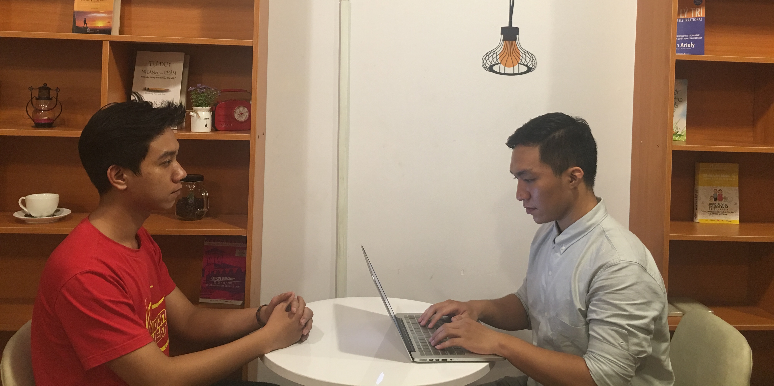
Customer Emotion
Problem
Mình sẽ giới thiệu cho anh ấy các dịch vụ khác

Slide 8
Customer Emotion
Problem
Thật phiền phức!
Mình chỉ muốn mở tài khoản thôi mà.
Mình sẽ giới thiệu cho anh ấy các dịch vụ khác
Notes:
Chọn hình để hiểu -> nói thêm

Slide 9

Customer Emotion
Problem
Thật phiền phức!
Mình chỉ muốn mở tài khoản thôi mà.
Mình sẽ giới thiệu cho anh ấy các dịch vụ khác
CONFLICT
Notes:
Chọn hình để hiểu -> nói thêm

Slide 10

Customer Emotion
Problem
Thật phiền phức

Slide 11
Customer Emotion
Problem
All of employees had been training before
Mr.Tan (Employee)

Slide 12
Customer Emotion
Problem
All of employees had been training before
All of employees are raising their skill every 3 months
Mr.Tan (Employee)

Slide 13
Customer Emotion
Problem
All of employees had been training before
All of employees are raising their skill every 3 months
BUT
Mr.Tan (Employee)
Employees don’t make customer happy

Slide 14
Customer Emotion
Our Proposal

Slide 15

Customer Emotion
Our Proposal
System

Slide 16
Customer Emotion
Our Proposal
Suggestion emotion
System

Slide 17
Customer Emotion
Our Proposal
Suggestion emotion
Employee will behave base on customer emotion
System

Slide 18
Customer Emotion
Our Proposal
Suggestion emotion
Employee will behave base on customer emotion
System
Customers shall feel satisfied

Slide 19
Customer Emotion
Our Proposal
Suggestion emotion
Employee will behave base on customer emotion
System
Customers shall feel satisfied
Record customer emotion

Slide 20
Customer Emotion
Our Proposal
Suggestion emotion
Employee will behave base on customer emotion
System
Customers shall feel satisfied
Record customer emotion
Manager can evalute employee performance

Slide 21
Customer Emotion
Our Proposal
Suggestion emotion
Employee will behave base on customer emotion
System
Customers shall feel satisfied
Record customer emotion
Manager can evalute employee performance
Improve
customer service

Slide 22
Customer Emotion
How’d we do that?
How??

Slide 23


Customer Emotion
How’d we do that?
Hidden Camera
System
Microsoft Cognitive
Services

Slide 24
Customer Emotion
How’d we do that?
Hidden Camera
System
Microsoft Cognitive
Services
Take a customer picture

Slide 25
Customer Emotion
How’d we do that?
Hidden Camera
System
Microsoft Cognitive
Services
Take a customer picture
Process

Slide 26
Customer Emotion
How’d we do that?
Hidden Camera
System
Microsoft Cognitive
Services
Take a customer picture
Process
Emotion recognition

Slide 27
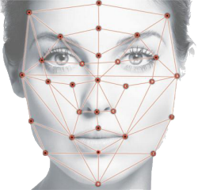
Customer Emotion
How’d we do that?
1. Take a picture
Camera
System
Face

Slide 28
Customer Emotion
How’d we do that?
2. Send image
1. Take a picture
Camera
System
Microsoft Cognitive
Services
Face

Slide 29
Customer Emotion
How’d we do that?
2. Send image
1. Take a picture
3. Response Emotion
Camera
System
Microsoft Cognitive
Services
Face

Slide 30

Customer Emotion
How’d we do that?
2. Send image
1. Take a picture
3. Response Emotion
Camera
System
Microsoft Cognitive
Services
Face
4. Process

Slide 31
Customer Emotion
How’d we do that?
2. Send image
1. Take a picture
3. Response Emotion
Camera
System
Microsoft Cognitive
Services
Face
4. Process
5. Record

Slide 32

Customer Emotion
How’d we do that?
2. Send image
1. Take a picture
3. Response Emotion
Camera
System
Microsoft Cognitive
Services
Face
4. Process
6. Notify
5. Record
Employees

Slide 33

Customer Emotion
Technical

Slide 34
Customer Emotion
Technical
Support detect emotion
Support detect face and identification
Diverse data, high accuracy

Slide 35
Customer Emotion
Emotion

Slide 36
Customer Emotion
Emotion
Science
Psychology
Emotion

Slide 37
Customer Emotion
Emotion
Science
Psychology
Emotion
detect face
Basic Emotion
Face

Slide 38
Customer Emotion
Emotion
Science
Psychology
Emotion
detect face
Basic Emotion
Face
Anger
Contempt
Disgust
Fear
Happiness
Neutral
Sadness
Surprise

Slide 39
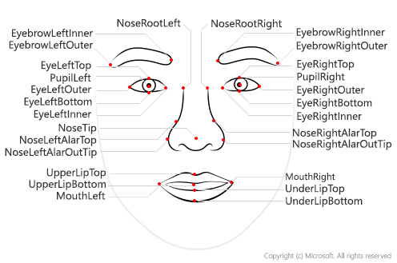
Customer Emotion
Basic emotion
Face Landmarks

Slide 40

Customer Emotion
Basic emotion
1. Surprise pattern
Eyebrows raised
Eyes widened
Mouth open light

Slide 41
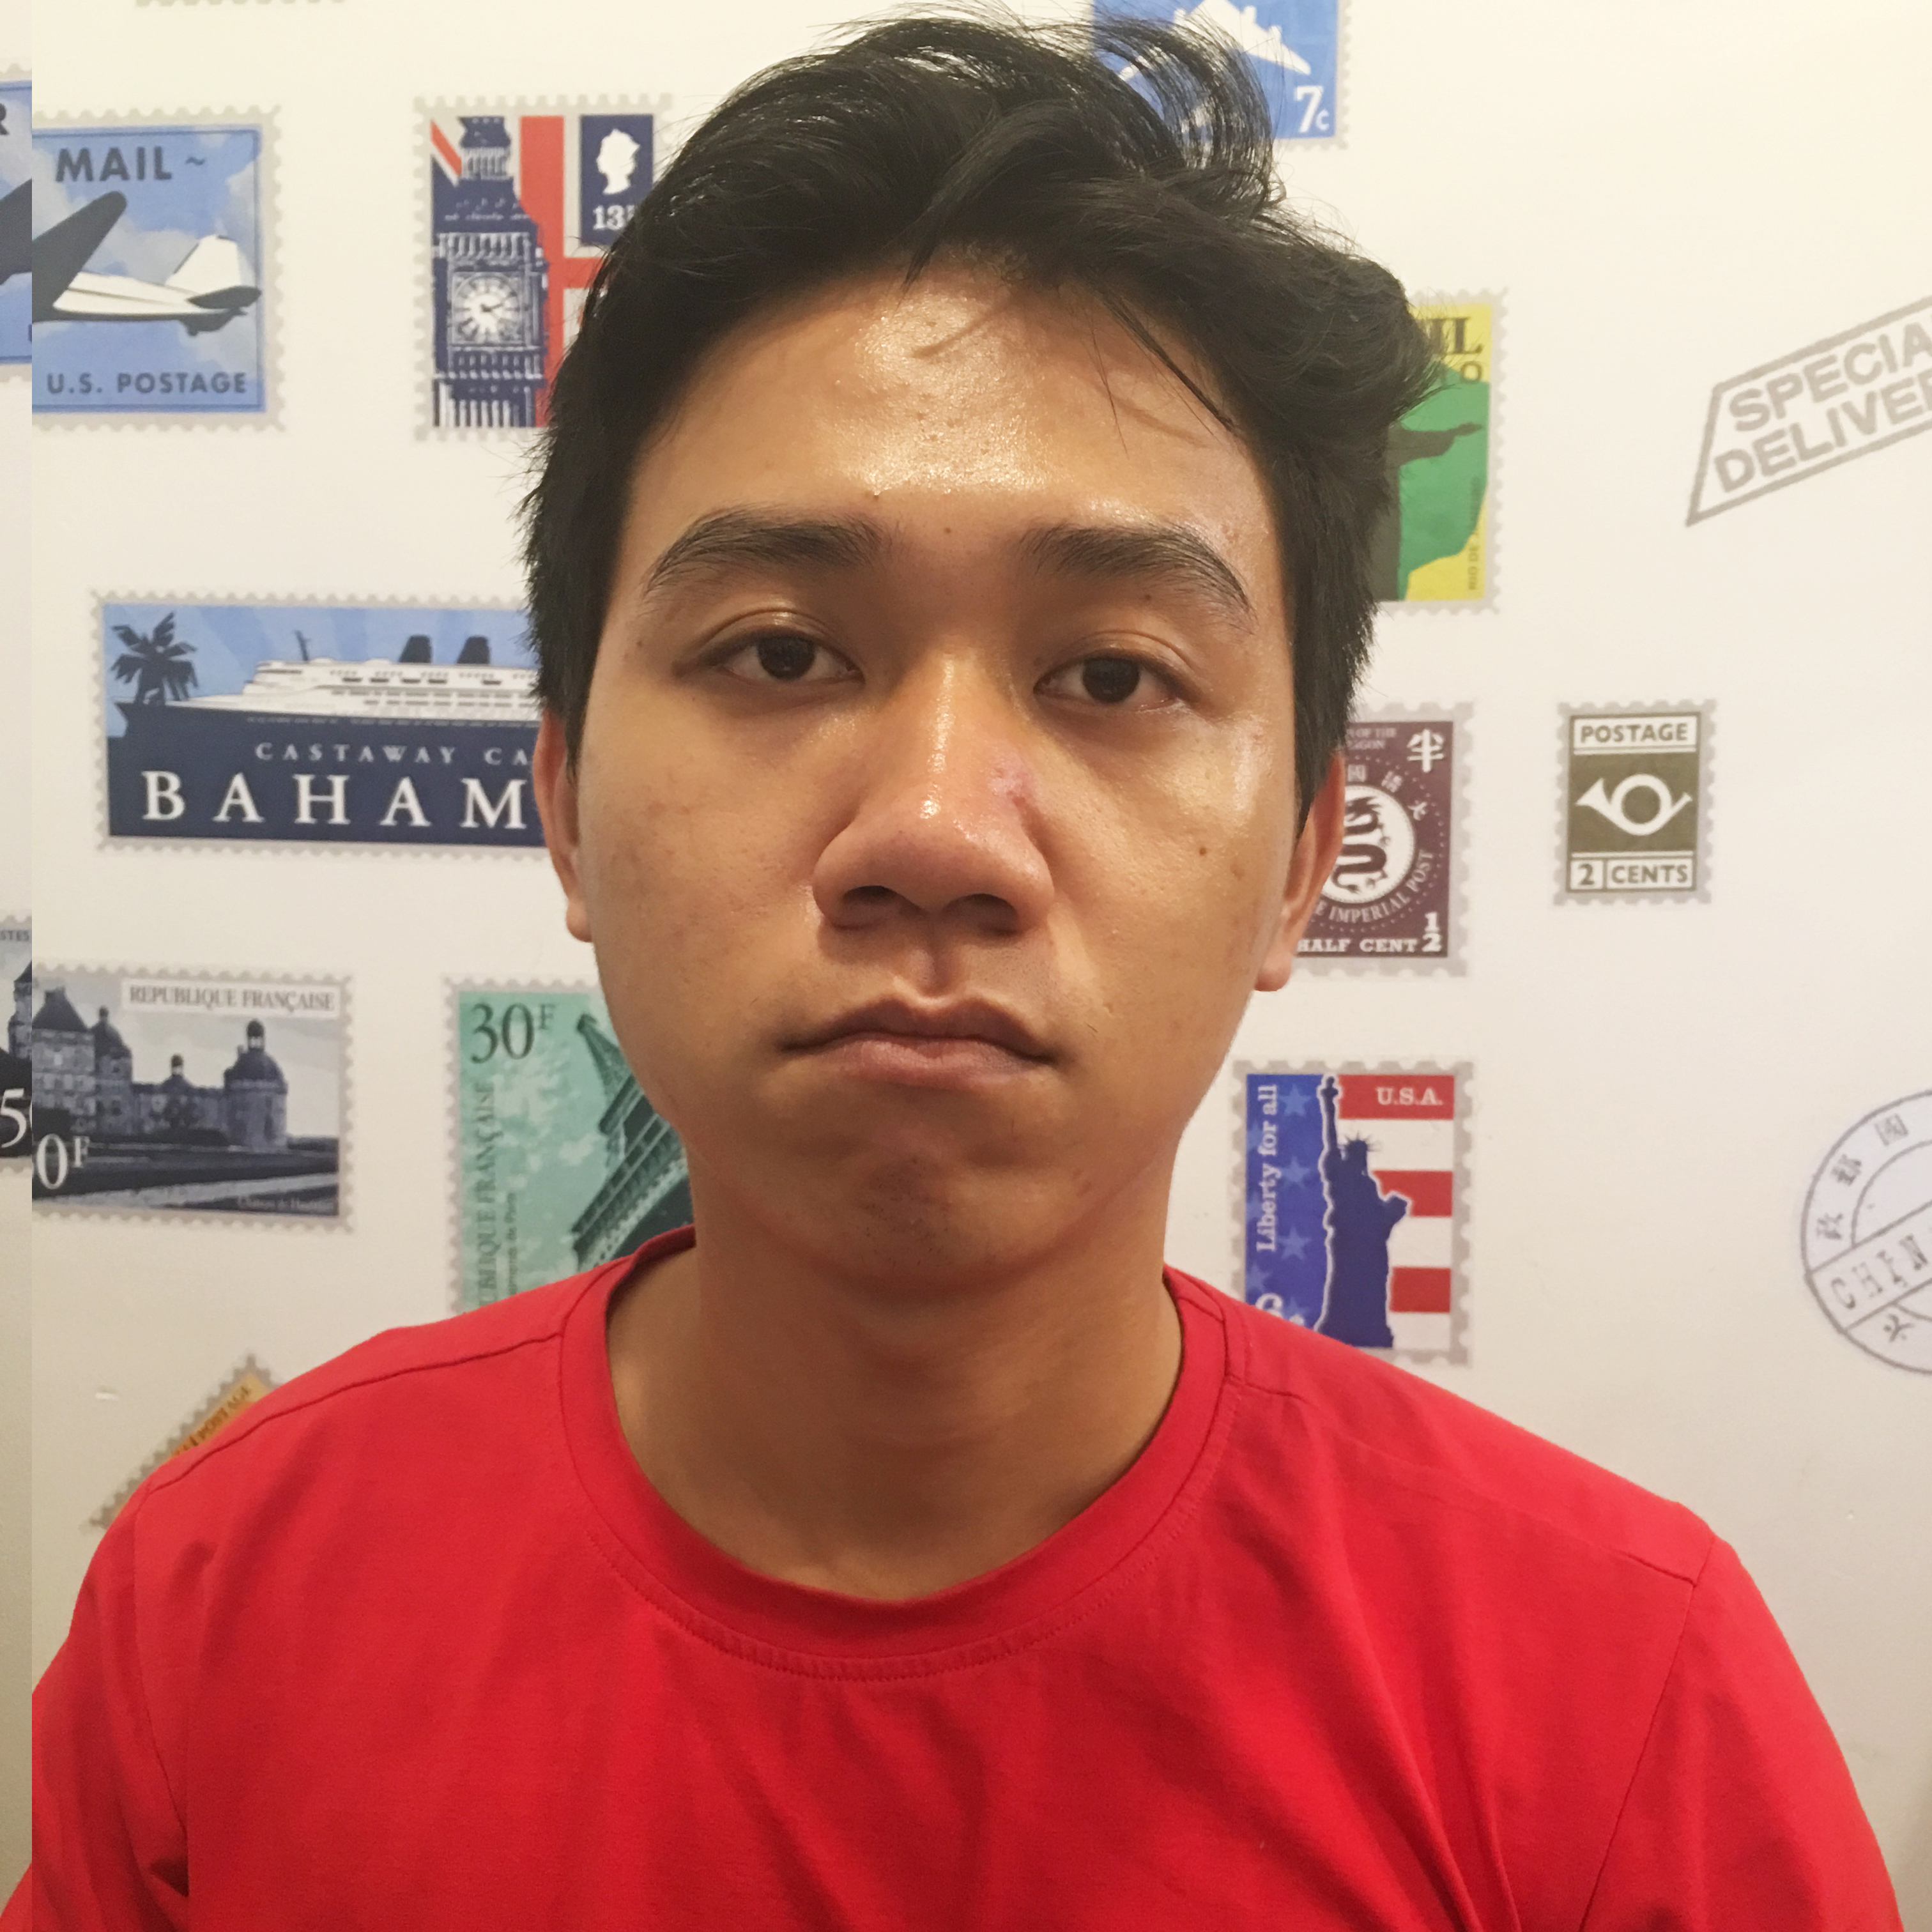
Customer Emotion
Basic emotion
2. Sadness pattern
Inner corners of eyebrows raised
Eyelids loose
Lip corners pulled down

Slide 42
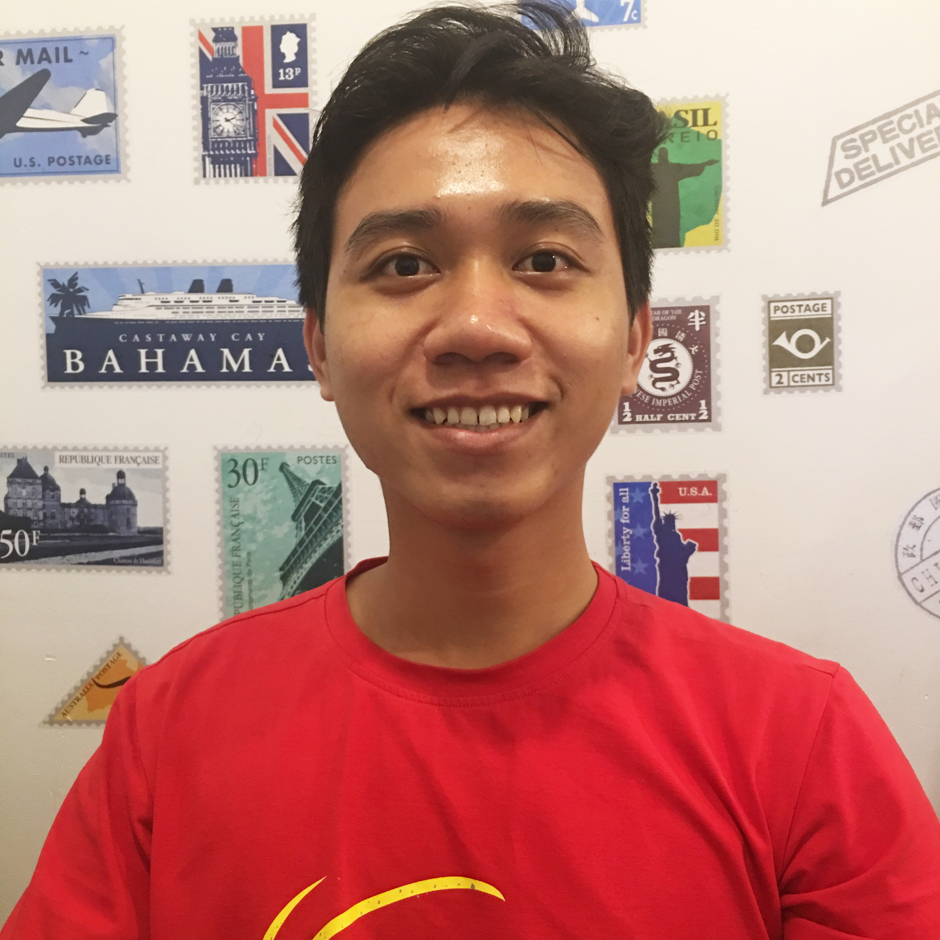
Customer Emotion
Basic emotion
3. Happy pattern
Cheeks raised
Lip corners pulled up

Slide 43
Customer Emotion
How does Emotion API work?

Slide 44
Customer Emotion
How does Emotion API work?
Input

Slide 45

Customer Emotion
How does Emotion API work?
Input
1. Convert to image black and white

Slide 46

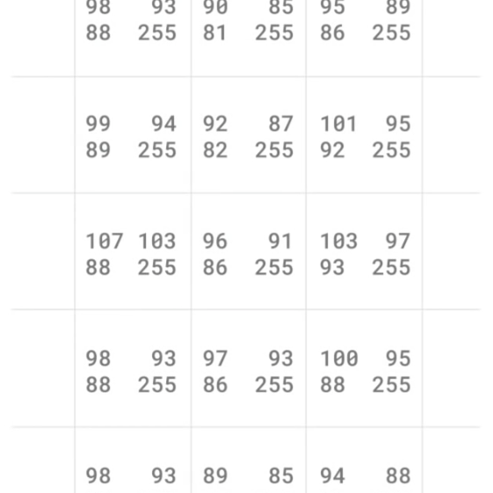
Customer Emotion
How does Emotion API work?
Input
1. Convert to image black and white
2. Scanning each pixel
3. Forming matrix

Slide 47
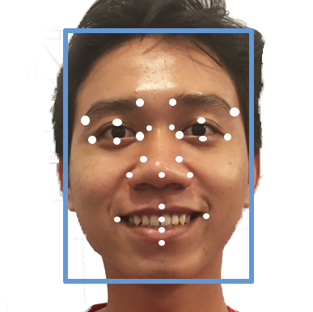
Customer Emotion
How does Emotion API work?
Input
1. Convert to image black and white
2. Scanning each pixel
4. Algorithms
3. Forming matrix

Slide 48
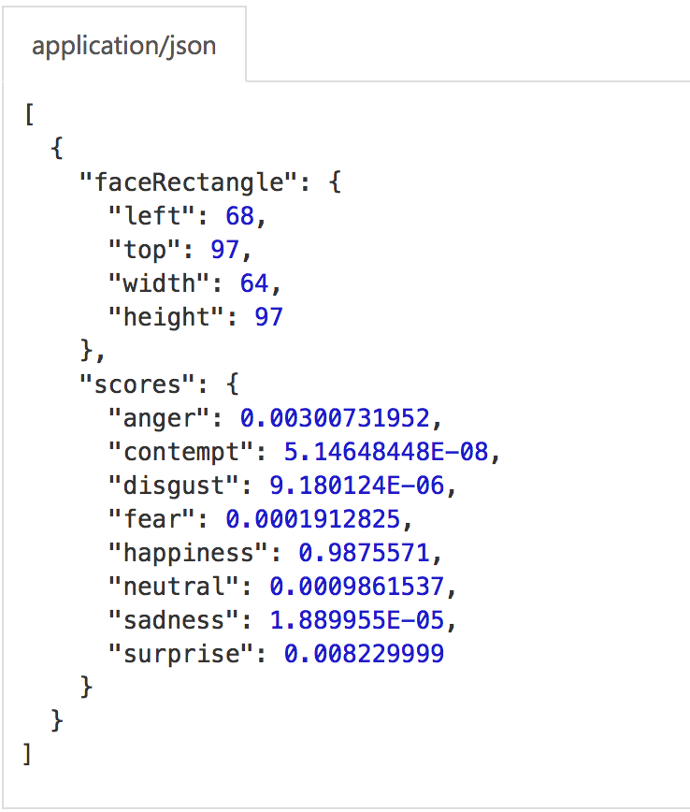
Customer Emotion
How does Emotion API work?
5. Calculate ratio in face landmark
Output
Compare
4. Algorithms

Slide 49
Customer Emotion
How does Emotion API work?
Output
Anger
Contempt
Disgust
Fear
Happiness
Neutral
Sadness
Surprise
[0..1]

Slide 50
Customer Emotion
Analyze Emotion Point
How do we know emotional indicators suitable for Vietnamese?
How??

Slide 51
Customer Emotion
Analyze Emotion Point
1. Survey
How do we know emotional indicators suitable for Vietnamese
Take survey

Slide 52

Customer Emotion
Take survey - Analyze Emotion Point
1. Survey
More than 1000 case
1. Age
2. Emotion point

Slide 53
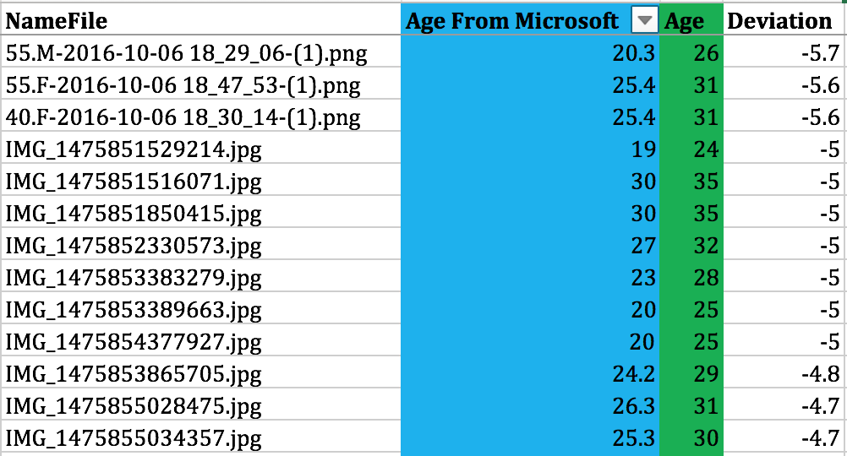
Customer Emotion
Take survey - Analyze Emotion Point
More than 1000 case
1. Age
2. Emotion point
Take a picture
Record age, emotion point

Slide 54
Customer Emotion
Age - Analyze Emotion Point
Survey
Correlation
1. Find the correlation
X : Age from Microsoft
Y : Survey age
N : Number of case

Slide 55
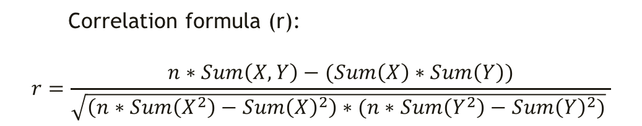
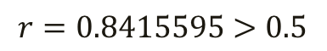
Customer Emotion
Age - Analyze Emotion Point
Survey
Correlation
1. Find the correlation
If the correlation > 0.5 so 2 data set have the relationship
Correlation formula (r):
$$r=\frac{n∗Sum\left(X,Y\right)−(Sum\left(X\right)∗Sum\left(Y\right))}{\sqrt{\left(n∗Sum\left(X^{2}\right)−{Sum\left(X\right)}^{2}\right)∗(n∗Sum\left(Y^{2}\right)−{Sum\left(Y\right)}^{2})} }$$
X : Age from Microsoft
Y : Survey age
N : Number of case
$$r=0.8415595>0.5$$
Age from Microsoft and Age have relationship.
http://www.investopedia.com/terms/c/correlation.asp

Slide 56
Customer Emotion
Age - Analyze Emotion Point
Survey
Correlation
Find relationship
1. Find the correlation
2. Find the relationship
X : Age from Microsoft
Y : Survey age
N : Number of case
Notes:
Là một cách dự đoán một biến quan tâm = từ những biếnt mà mình tìm được
Sau khi có output từ learn regression ->
Xác định range

Slide 57
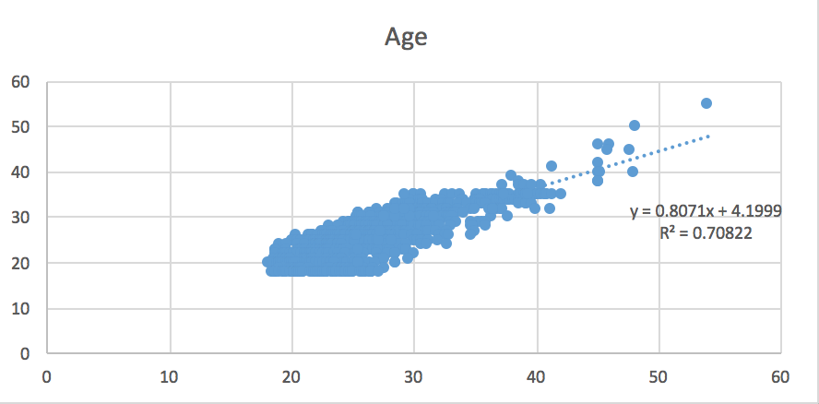
Customer Emotion
Age - Analyze Emotion Point
Survey
Correlation
Find relationship
1. Find the correlation
2. Find the relationship
We apply linear regression to predict Age from survey data.
Linear regression is an approach for modeling the relationship between a dependent variable Y and independent variables X
X : Age from Microsoft
Y : Survey Age
N : Number of case
x: Age from Microsoft
y: Estimate age
y = 0.8071*x + 4.1999
https://en.wikipedia.org/wiki/Linear_regression

Slide 58
Customer Emotion
Age - Analyze Emotion Point
Survey
Correlation
Find relationship
Find range
1. Find the correlation
2. Find the relationship
3. Find the range to increase accuracy
X : Age from Microsoft
Y : Survey age
N : Number of case
https://en.wikipedia.org/wiki/Deviation

Slide 59
Customer Emotion
Age - Analyze Emotion Point
Survey
Correlation
Find relationship
Find range
1. Find the correlation
2. Find the relationship
3. Find the range to increase accuracy
3.1. Calculate deviation value
X : Age from Microsoft
Y : Survey age
N : Number of case
https://en.wikipedia.org/wiki/Deviation

Slide 60
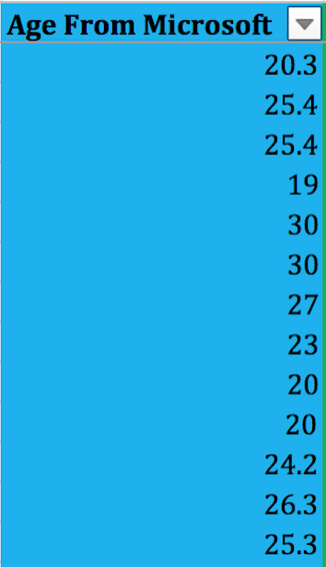
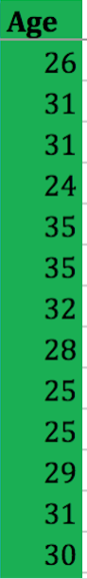
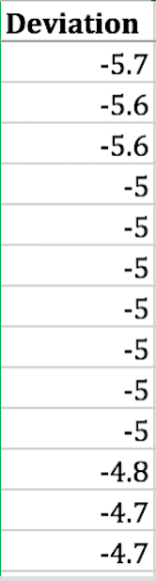
Customer Emotion
Age - Analyze Emotion Point
Survey
Correlation
Find relationship
Find range
1. Find the correlation
2. Find the relationship
3. Find the range to increase accuracy
3.1. Calculate deviation value
X : Age from Microsoft
Y : Survey age
N : Number of case
-
=
https://en.wikipedia.org/wiki/Deviation

Slide 61
Customer Emotion
Age - Analyze Emotion Point
Survey
Correlation
Find relationship
Find range
1. Find the correlation
2. Find the relationship
3. Find the range to increase accuracy
3.1. Calculate deviation value
3.2. Calculate range value
X : Age from Microsoft
Y : Survey age
N : Number of case
Range =
Average( )
Range = 1.09126
https://en.wikipedia.org/wiki/Deviation

Slide 62
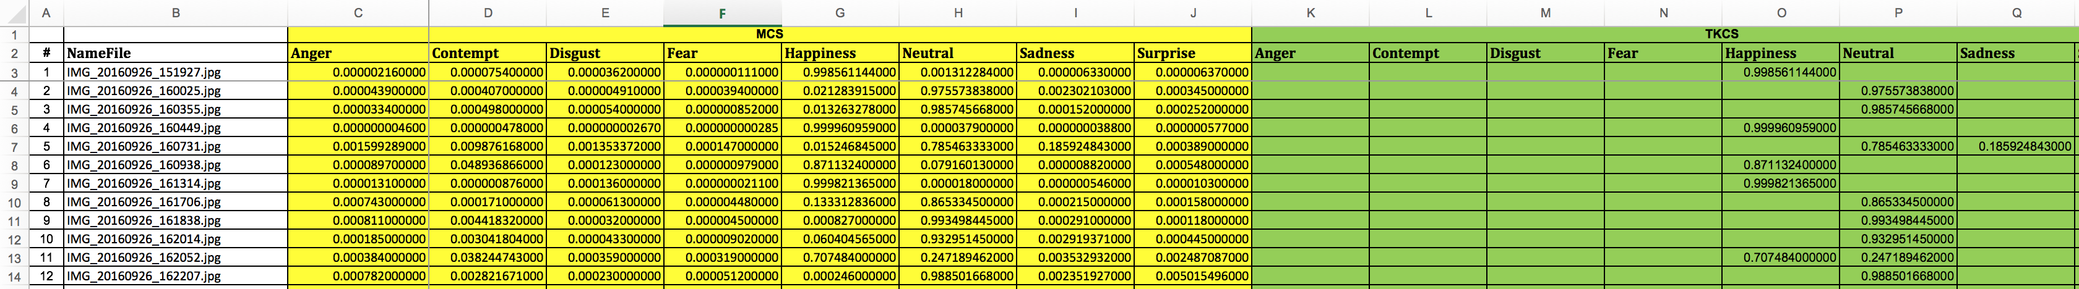
Customer Emotion
Emotion Point- Analyze Emotion Point
Survey
Customer emotion survey

Slide 63
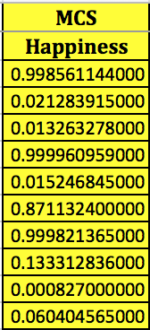
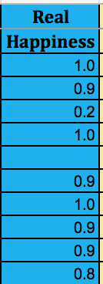
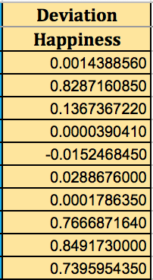
Customer Emotion
Emotion Point- Analyze Emotion Point
Survey
Calculate deviation
Customer emotion survey
Apply “Minimum difference” to calculate the bound of each emotion point
1. Calculate deviation value
Happy
Deviation
value
-
=
https://en.wikipedia.org/wiki/Deviation
Notes:
Đưa ra một dự đoán chính xác hơn.
out estimation out boundary estimation

Slide 64
Customer Emotion
Emotion Point- Analyze Emotion Point
Survey
Calculate deviation
Find bound
Customer emotion survey
Apply “Minimum difference” to calculate the bound of each emotion point
1. Calculate deviation value
2. Bound is equal average deviation value.
Bound =
Average( )
Notes:
Đưa ra một dự đoán chính xác hơn.
out estimation out boundary estimation

Slide 65
Customer Emotion
Emotion Point- Analyze Emotion Point
Survey
Calculate deviation
Find bound
Customer emotion survey
Apply “Minimum difference” to calculate the bound of each emotion point
Anger bound 0.050440242667
Contempt bound 0.006642985222
Disgust bound 0.006355223500
Fear bound -0.049538192000
Happiness bound 0.001384727216
Neutral bound 0.018111263197
Sadness bound 0.018469496200
Surprise bound 0.007464739500

Slide 66

Customer Emotion
Algorithms - Analyze Emotion Point

Slide 67
Customer Emotion
Algorithms - Analyze Emotion Point

Slide 68
Customer Emotion
Algorithms - Analyze Emotion Point
Age 20.4
Gender Female
Detect face

Slide 69
Customer Emotion
Algorithms - Analyze Emotion Point
Get emotion point
Age 20.4
Gender Female
Detect face
Anger 0.0008
Contempt 0.0071
Disgust 0.0042
Fear 0.0012
Happiness 0.9914
Neutral 0.0023
Sadness 0.0001
Surprise 0.0032
Detect Emotion
Emotions
Ratio

Slide 70
Customer Emotion
Algorithms - Analyze Emotion Point -
Apply Data mining
Get emotion point
Estimate
Age 20.4
Gender Female
Anger 0.0008
Contempt 0.0071
Disgust 0.0042
Fear 0.0012
Happiness 0.9914
Neutral 0.0023
Sadness 0.0001
Surprise 0.0032

Slide 71
Customer Emotion
Algorithms - Analyze Emotion Point -
Apply Data mining
Get emotion point
Estimate
Mining for Age
Age 20.4
Gender Female
y = 0.8071*x + 4.1999
range = 1.09126
Anger 0.0008
Contempt 0.0071
Disgust 0.0042
Fear 0.0012
Happiness 0.9914
Neutral 0.0023
Sadness 0.0001
Surprise 0.0032

Slide 72
Customer Emotion
Algorithms - Analyze Emotion Point -
Apply Data mining
Get emotion point
Estimate
Mining for Age
Age 20.4
Gender Female
Age 20.7
Gender Female
y = 0.8071*x + 4.1999
range = 1.09126
Anger 0.0008
Contempt 0.0071
Disgust 0.0042
Fear 0.0012
Happiness 0.9914
Neutral 0.0023
Sadness 0.0001
Surprise 0.0032

Slide 73
Customer Emotion
Algorithms - Analyze Emotion Point -
Apply Data mining
Get emotion point
Estimate
Mining for Age
Age 20.4
Gender Female
Age 20.7
Gender Female
y = 0.8071*x + 4.1999
range = 1.09126
Anger 0.0008
Contempt 0.0071
Disgust 0.0042
Fear 0.0012
Happiness 0.9914
Neutral 0.0023
Sadness 0.0001
Surprise 0.0032
Mining for Emotion
Anger bound 0.050440242667
Contempt bound 0.006642985222
Disgust bound 0.006355223500
Fear bound -0.049538192000
Happiness bound 0.001384727216
Neutral bound 0.018111263197
Sadness bound 0.018469496200
Surprise bound 0.007464739500

Slide 74
Customer Emotion
Algorithms - Analyze Emotion Point -
Apply Data mining
Get emotion point
Estimate
Mining for Age
Age 20.4
Gender Female
Age 20.7
Gender Female
y = 0.8071*x + 4.1999
range = 1.09126
Anger 0.0508
Contempt 0.0111
Disgust 0.0102
Fear 0.0002
Happiness 0.9927
Neutral 0.0023
Sadness 0.0019
Surprise 0.0047
Anger 0.0008
Contempt 0.0071
Disgust 0.0042
Fear 0.0012
Happiness 0.9914
Neutral 0.0023
Sadness 0.0001
Surprise 0.0032
Mining for Emotion
Anger bound 0.050440242667
Contempt bound 0.006642985222
Disgust bound 0.006355223500
Fear bound -0.049538192000
Happiness bound 0.001384727216
Neutral bound 0.018111263197
Sadness bound 0.018469496200
Surprise bound 0.007464739500

Slide 75
Customer Emotion
Algorithms - Analyze Emotion Point -
Apply Data mining
Get emotion point
Estimate
Input
Mining for Age
Age 20.4
Gender Female
Age 20.7
Gender Female
y = 0.8071*x + 4.1999
range = 1.09126
Anger 0.0508
Contempt 0.0111
Disgust 0.0102
Fear 0.0002
Happiness 0.9927
Neutral 0.0023
Sadness 0.0019
Surprise 0.0047
Anger 0.0008
Contempt 0.0071
Disgust 0.0042
Fear 0.0012
Happiness 0.9914
Neutral 0.0023
Sadness 0.0001
Surprise 0.0032
Mining for Emotion
Anger bound 0.050440242667
Contempt bound 0.006642985222
Disgust bound 0.006355223500
Fear bound -0.049538192000
Happiness bound 0.001384727216
Neutral bound 0.018111263197
Sadness bound 0.018469496200
Surprise bound 0.007464739500

Slide 76
Customer Emotion
Algorithms - Analyze Emotion Point - Message
Get emotion point
Estimate
Transform message
Input
Age 20.7
Gender Female
Anger 0.0508
Contempt 0.0111
Disgust 0.0102
Fear 0.0002
Happiness 0.9927
Neutral 0.0023
Sadness 0.0019
Surprise 0.0047

Slide 77

Customer Emotion
Algorithms - Analyze Emotion Point - Message
Get emotion point
Estimate
Transform message
Input
Age 20.7
Gender Female
Analyze Emotion Point Algorithms
Output
Anger 0.0508
Contempt 0.0111
Disgust 0.0102
Fear 0.0002
Happiness 0.9927
Neutral 0.0023
Sadness 0.0019
Surprise 0.0047
Bà ấy có vẻ rất vui vẻ.

Slide 78
Customer Emotion
Algorithms - Analyze Emotion Point - Message
Get emotion point
Estimate
Transform message
Bà ấy có vẻ rất vui vẻ.
Chủ ngữ
Vị ngữ

Slide 79
Customer Emotion
Algorithms - Analyze Emotion Point - Message
Get emotion point
Estimate
Transform message
Bà ấy có vẻ rất vui vẻ.
Chủ ngữ
Tính từ
Thành phần biệt lập
Bổ ngữ

Slide 80
Customer Emotion
Algorithms - Analyze Emotion Point - Message
Get emotion point
Estimate
Transform message
Age 20.7
Gender Female
Bà ấy có vẻ rất vui vẻ.
Chủ ngữ
Tính từ
Thành phần biệt lập
Bổ ngữ

Slide 81
Customer Emotion
Algorithms - Analyze Emotion Point - Message
Get emotion point
Estimate
Transform message
Age 20.7
Gender Female
Bà ấy có vẻ rất vui vẻ.
Chủ ngữ
Tính từ
Thành phần biệt lập
Bổ ngữ

Slide 82
Customer Emotion
Algorithms - Analyze Emotion Point - Message
Get emotion point
Estimate
Transform message
Anger 0.0508
Contempt 0.0111
Disgust 0.0102
Fear 0.0002
Happiness 0.9927
Neutral 0.0023
Sadness 0.0019
Surprise 0.0047
Age 20.7
Gender Female
Bà ấy có vẻ rất vui vẻ.
Chủ ngữ
Tính từ
Thành phần biệt lập
Bổ ngữ

Slide 83
Customer Emotion
Algorithms - Analyze Emotion Point
Get emotion point
Estimate
Transform message
Em ấy
Age < 16
Age

Slide 84
Customer Emotion
Algorithms - Analyze Emotion Point
Get emotion point
Estimate
Transform message
Em ấy
Age < 16
Age
Age >= 16

Slide 85
Customer Emotion
Algorithms - Analyze Emotion Point
Get emotion point
Estimate
Transform message
Em ấy
Age < 16
Age
Ông ấy
Age >= 16
Gender = ‘Male’
Gender

Slide 86
Customer Emotion
Algorithms - Analyze Emotion Point
Get emotion point
Estimate
Transform message
Em ấy
Age < 16
Age
Ông ấy
Age >= 16
Gender = ‘Male’
Gender
Gender = ‘Female’
Bà ấy

Slide 87
Customer Emotion
Algorithms - Analyze Emotion Point
Get emotion point
Estimate
Transform message
0.15
0.45
0.65
0.75
1
Một ít
Một phần
Gần như
Rất

Slide 88
Customer Emotion
Algorithms - Analyze Emotion Point
Get emotion point
Estimate
Transform message
Anger
Contempt
Disgust
Fear
Happiness
Neutral
Sadness
Surprise
Giận dữ
Khinh Thường
Căm phẫn
Sợ hãi
Hạnh phúc
Bình thường
Buồn
Ngạc nhiên
0
1
2
3
4
5
6
7

Slide 89
Customer Emotion
Algorithms - Analyze Emotion Point – Example
Get emotion point
Estimate
Transform message
Happiness 0.99
Rất vui vẻ

Slide 90
Customer Emotion
Algorithms - Analyze Emotion Point – Example
Get emotion point
Estimate
Transform message
Happiness 0.99
Rất vui vẻ
Anger 0.4
Có vẻ giận dữ

Slide 91
Customer Emotion
Algorithms - Analyze Emotion Point – Example
Get emotion point
Estimate
Transform message
Happiness 0.99
Rất vui vẻ
Anger 0.4
Có vẻ giận dữ
Sadness 0.16
Một ít buồn

Slide 92
Customer Emotion
Algorithms - Analyze Emotion Point
Get emotion point
Estimate
Transform message
Anger 0.0508
Contempt 0.0111
Disgust 0.0102
Fear 0.0002
Happiness 0.9927
Neutral 0.0023
Sadness 0.0019
Surprise 0.0047

Slide 93
Customer Emotion
Algorithms - Analyze Emotion Point
Get emotion point
Estimate
Transform message
Optimize
Anger 0.0508
Contempt 0.0111
Disgust 0.0102
Fear 0.0002
Happiness 0.9927
Neutral 0.0023
Sadness 0.0019
Surprise 0.0047
Anger 0.0508
Contempt 0.0111
Disgust 0.0102
Fear 0.0002
Happiness 0.9927
Neutral 0.0023
Sadness 0.0019
Surprise 0.0047
Happiness 0.9927
Remove Value < 0.15
Why does we remove 0.15 ?

Slide 94
Customer Emotion
Algorithms - Analyze Emotion Point
Get emotion point
Estimate
Transform message
Optimize
Anger 0.0508
Contempt 0.0111
Disgust 0.0102
Fear 0.0002
Happiness 0.9927
Neutral 0.0023
Sadness 0.0019
Surprise 0.0047
Anger 0.0508
Contempt 0.0111
Disgust 0.0102
Fear 0.0002
Happiness 0.9927
Neutral 0.0023
Sadness 0.0019
Surprise 0.0047
Happiness 0.9927
Remove Value < 0.15
Rất vui vẻ
0.15 is a bound value

Slide 95
Customer Emotion
Algorithms - Analyze Emotion Point
Get emotion point
Estimate
Transform message
Optimize
Age 20.4
Gender Female
Chủ ngữ
Anger 0.0508
Contempt 0.0111
Disgust 0.0102
Fear 0.0002
Happiness 0.9927
Neutral 0.0023
Sadness 0.0019
Surprise 0.0047
Vị ngữ

Slide 96
Customer Emotion
Algorithms - Analyze Emotion Point
Get emotion point
Estimate
Transform message
Optimize
Age 20.4
Gender Female
Chủ ngữ
Bà ấy
Anger 0.0508
Contempt 0.0111
Disgust 0.0102
Fear 0.0002
Happiness 0.9927
Neutral 0.0023
Sadness 0.0019
Surprise 0.0047
Vị ngữ

Slide 97
Customer Emotion
Algorithms - Analyze Emotion Point
Get emotion point
Estimate
Transform message
Optimize
Age 20.4
Gender Female
Chủ ngữ
Bà ấy
Anger 0.0508
Contempt 0.0111
Disgust 0.0102
Fear 0.0002
Happiness 0.9927
Neutral 0.0023
Sadness 0.0019
Surprise 0.0047
Vị ngữ
có vẻ rất vui vẻ.

Slide 98
Customer Emotion
Algorithms - Analyze Emotion Point
Get emotion point
Estimate
Transform message
Optimize
Age 20.4
Gender Female
Chủ ngữ
Bà ấy
Anger 0.0508
Contempt 0.0111
Disgust 0.0102
Fear 0.0002
Happiness 0.9927
Neutral 0.0023
Sadness 0.0019
Surprise 0.0047
Vị ngữ
có vẻ rất vui vẻ.
Bà ấy có vẻ rất vui vẻ.

Slide 99
Customer Emotion
Algorithms - Analyze Emotion Point
Get emotion point
Estimate
Transform message
Optimize
Input
Output
Age 20.4
Gender Female
Anger 0.0508
Contempt 0.0111
Disgust 0.0102
Fear 0.0002
Happiness 0.9927
Neutral 0.0023
Sadness 0.0019
Surprise 0.0047
Algorithms
Emotions
Ratio

Slide 100
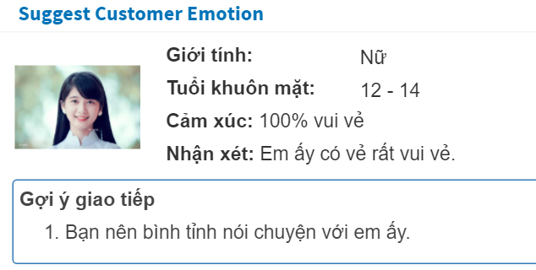
Customer Emotion
Algorithms - Analyze Emotion Point
Get emotion point
Estimate
Transform message
Optimize
Finish
Input
Output
Age 20.4
Gender Female
Anger 0.0508
Contempt 0.0111
Disgust 0.0102
Fear 0.0002
Happiness 0.9927
Neutral 0.0023
Sadness 0.0019
Surprise 0.0047
Algorithms
Emotions
Ratio

Slide 101
Customer Emotion
Algorithms - Analyze Emotion Point
Get emotion point
Estimate
Transform message
Optimize
Finish
Input
Output
Age 20.4
Gender Female
Emotion Message
Anger 0.0508
Contempt 0.0111
Disgust 0.0102
Fear 0.0002
Happiness 0.9927
Neutral 0.0023
Sadness 0.0019
Surprise 0.0047
Algorithms
Emotions
Ratio

Slide 102
Customer Emotion
Algorithms - Analyze Emotion Point
Get emotion point
Estimate
Transform message
Optimize
Finish
Input
Output
Age 20.4
Gender Female
Emotion Message
Anger 0.0508
Contempt 0.0111
Disgust 0.0102
Fear 0.0002
Happiness 0.9927
Neutral 0.0023
Sadness 0.0019
Surprise 0.0047
Algorithms
Emotions
Ratio
Suggestion

Slide 103
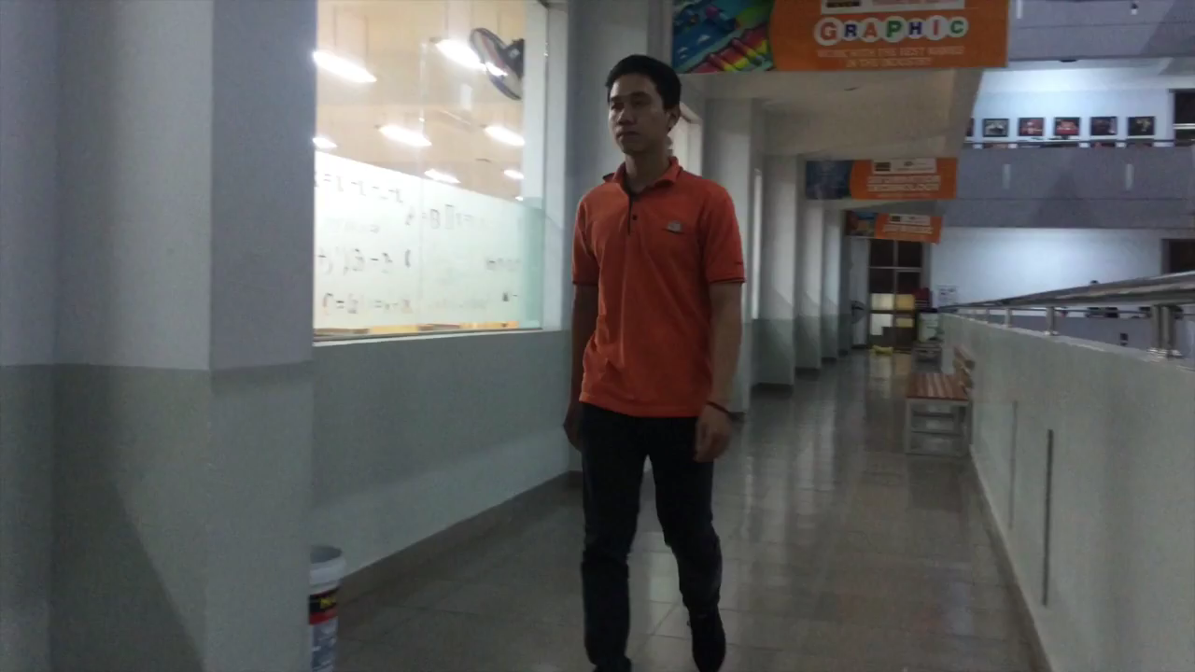
Customer Emotion
Demo – Customer Emotion
Scenario: Mr.Sang goes to bank again

Slide 104
Introduction
1. Customer Emotion
2. Timekeeping
Notes:
Thể hiện ý nghĩa 2 phần rõ ràng

Slide 105

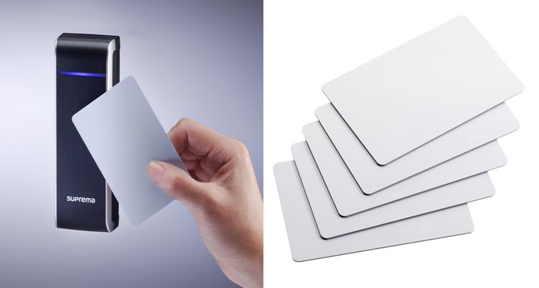
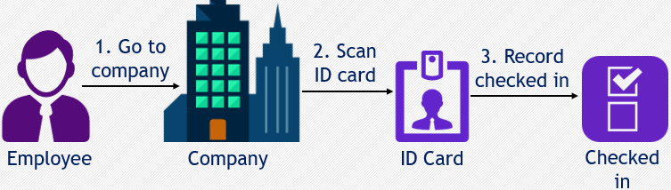
Problem
Timekeeping
ID card
Traditional checking employee in methods
Using ID card
Process

Slide 106

Problem
Timekeeping
ID card
Traditional checking employee in methods
Using ID card
Disadvantages
Can be faked
Forgot bringing ID card
Lost the ID card
Process

Slide 107
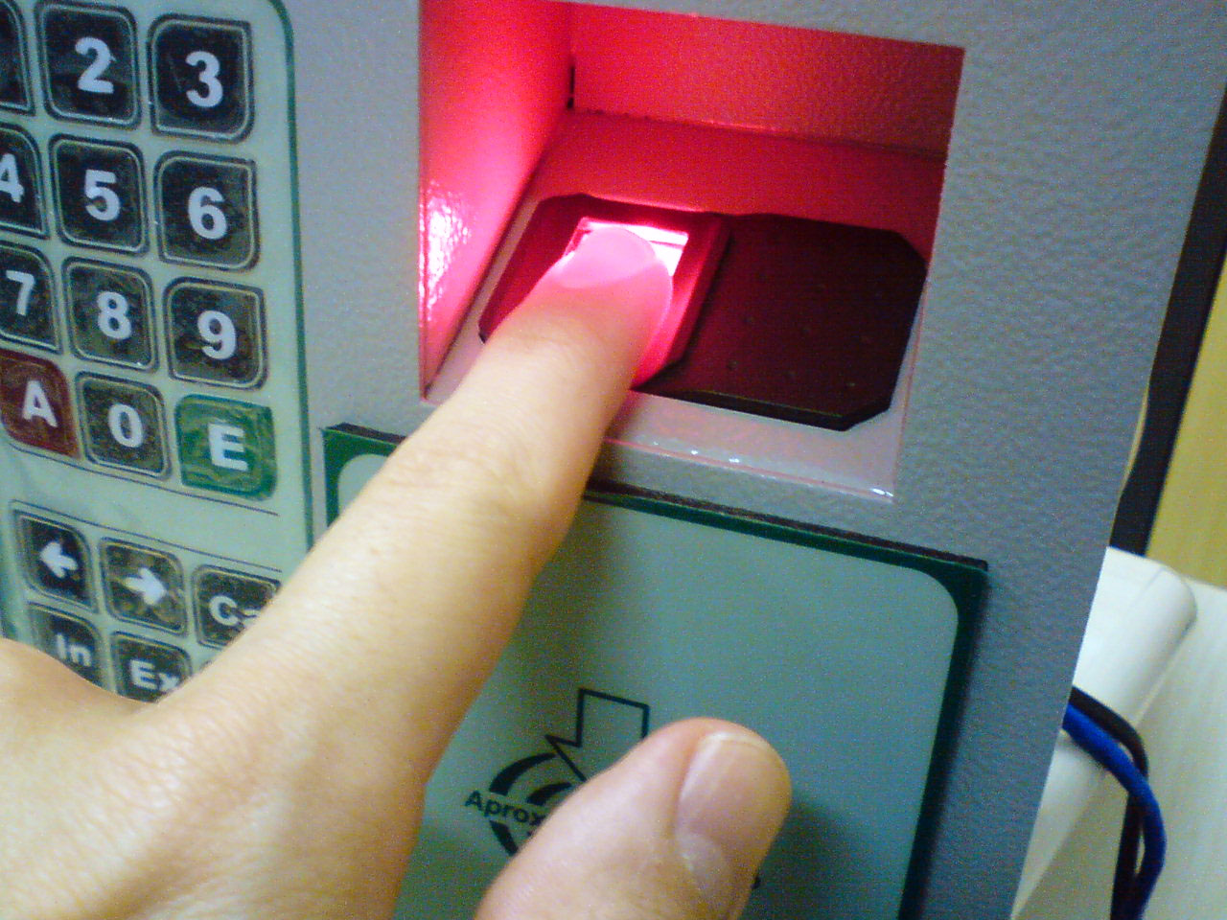
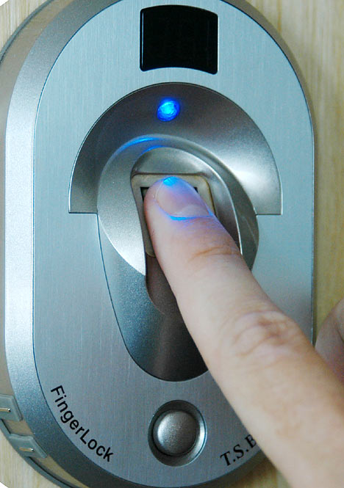
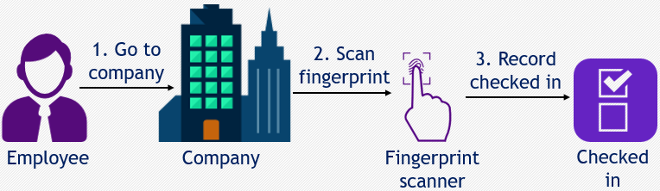
Problem
Timekeeping
ID card
Fingerprint
Traditional checking employee in methods
Using fingerprint scanner
Process

Slide 108
Problem
Timekeeping
ID card
Fingerprint
Traditional checking employee in methods
Using fingerprint scanner
Disadvantages
Can be faked
Has problem in hand (Ex: diseases of hand)
Process

Slide 109
Problem - Summary
Timekeeping
ID card
Fingerprint
Summary
Traditional checking employee in methods

Slide 110

Problem - Summary
Timekeeping
ID card
Fingerprint
Summary
Traditional checking employee in methods
Using ID card

Slide 111

Problem - Summary
Timekeeping
ID card
Fingerprint
Summary
Traditional checking employee in methods
Using ID card
Using fingerprint scanner

Slide 112
Problem - Summary
Timekeeping
ID card
Fingerprint
Summary
Traditional checking employee in methods
Using ID card
Disadvantages
Using fingerprint scanner

Slide 113
Problem - Summary
Timekeeping
ID card
Fingerprint
Summary
Traditional checking employee in methods
Using ID card
Can be faked
Disadvantages
Using fingerprint scanner

Slide 114
Problem - Summary
Timekeeping
ID card
Fingerprint
Summary
Traditional checking employee in methods
Using ID card
Can be faked
Disadvantages
Can not check-in when:
Using fingerprint scanner

Slide 115
Problem - Summary
Timekeeping
ID card
Fingerprint
Summary
Traditional checking employee in methods
Using ID card
Can be faked
Disadvantages
Can not check-in when:
Forgetting to bring ID card
Using fingerprint scanner

Slide 116
Problem - Summary
Timekeeping
ID card
Fingerprint
Summary
Traditional checking employee in methods
Using ID card
Can be faked
Disadvantages
Can not check-in when:
Forgetting to bring ID card
Losing ID card
Using fingerprint scanner

Slide 117
Problem - Summary
Timekeeping
ID card
Fingerprint
Summary
Traditional checking employee in methods
Using ID card
Can be faked
Disadvantages
Can not check-in when:
Forgetting to bring ID card
Losing ID card
Having problem in hand
Using fingerprint scanner

Slide 118
Our Proposal
Timekeeping
System

Slide 119

Our Proposal
Timekeeping
Support to check-in by camera
System

Slide 120
Our Proposal
Timekeeping
Support to check-in by camera
System
Improve check employee in when forgetting to bring ID card or having problem with hand

Slide 121
How’d we do that?
Timekeeping
How??

Slide 122
How’d we do that?
Timekeeping
Microsoft Cognitive
Services
Camera
System

Slide 123
How’d we do that?
Timekeeping
Microsoft Cognitive
Services
Camera
System
Automatically take picture

Slide 124
How’d we do that?
Timekeeping
Microsoft Cognitive
Services
Camera
System
Automatically take picture
Record checked employee in

Slide 125
How’d we do that?
Timekeeping
Microsoft Cognitive
Services
Camera
System
Automatically take picture
Record checked employee in
Identify person

Slide 126
How’d we do that?
Timekeeping
1. Take picture
Camera
System
Face

Slide 127
How’d we do that?
Timekeeping
1. Take picture
2. Send image
Camera
System
Microsoft Cognitive
Services
Face

Slide 128
How’d we do that?
Timekeeping
1. Take picture
2. Send image
3. Response
Camera
System
Microsoft Cognitive
Services
Face
Notes:
Ngày nay, hầu hết các công ty sử dụng việc quẹt thẻ từ ID để chấm công cho nhân viên

Slide 129
How’d we do that?
Timekeeping
1. Take picture
2. Send image
3. Response
Camera
System
Microsoft Cognitive
Services
Face
4. Process
Notes:
Ngày nay, hầu hết các công ty sử dụng việc quẹt thẻ từ ID để chấm công cho nhân viên

Slide 130
How’d we do that?
Timekeeping
1. Take picture
2. Send image
3. Response
Camera
System
Microsoft Cognitive
Services
Face
4. Process
5. Record
Notes:
Ngày nay, hầu hết các công ty sử dụng việc quẹt thẻ từ ID để chấm công cho nhân viên

Slide 131
Explain Features
Timekeeping
How??

Slide 132
Training Process
Timekeeping
Face API - Concepts
Microsoft Cognitive Services - Face
Person Group
Person
Face

Slide 133
Training Process
Timekeeping
Face API - Concepts
Microsoft Cognitive Services - Face
Person Group
Person
Face
A person is a basic unit of identify
Person

Slide 134
Training Process
Timekeeping
Face API - Concepts
Microsoft Cognitive Services - Face
Person Group
Person
Face
A person is a basic unit of identify
A baseline to identify people
Person
Face

Slide 135
Training Process
Timekeeping
Face API - Concepts
Microsoft Cognitive Services - Face
Person Group
Person
Face
A person group is a collection of people
A person is a basic unit of identify
A baseline to identify people
Person Group
Person
Face

Slide 136
Training Process
Timekeeping
Face API - Concepts
Person Group
Person
Face
Purpose

Slide 137
Training Process
Timekeeping
Face API - Concepts
Person Group
Person
Face
Purpose
Faster searching

Slide 138
Training Process
Timekeeping
Mapping
Microsoft Cognitive Services

Slide 139
Training Process
Timekeeping
Mapping
Microsoft Cognitive Services
Person Group
1
∞
Person
Face
1
∞

Slide 140
Training Process
Timekeeping
Mapping
Microsoft Cognitive Services
System
Person Group
1
∞
Person
Face
1
∞

Slide 141
Training Process
Timekeeping
Mapping
Microsoft Cognitive Services
System
Person Group
1
Department
1
∞
∞
Person
Account
Face
1
Face
1
∞
∞

Slide 142
Training Process
Timekeeping
Mapping
Microsoft Cognitive Services
System
Person Group
1
Department
1
∞
∞
Person
Account
Face
1
Face
1
∞
∞

Slide 143
Algorithms - Training Employee Image
Timekeeping

Slide 144
Algorithms - Training Employee Image
Timekeeping
Preparation Training
Process Training
Finish Training
Notes:
Ngày nay, hầu hết các công ty sử dụng việc quẹt thẻ từ ID để chấm công cho nhân viên

Slide 145
Algorithms – Training Employee Image - Preparation
Timekeeping
1. Pre-training
Notes:
Ngày nay, hầu hết các công ty sử dụng việc quẹt thẻ từ ID để chấm công cho nhân viên

Slide 146

Algorithms – Training Employee Image - Preparation
Timekeeping
1. Pre-training
TKCS
Create Department
Admin
Notes:
Ngày nay, hầu hết các công ty sử dụng việc quẹt thẻ từ ID để chấm công cho nhân viên

Slide 147
Algorithms – Training Employee Image - Preparation
Timekeeping
1. Pre-training
TKCS
Department
Create Department
Admin
Notes:
Ngày nay, hầu hết các công ty sử dụng việc quẹt thẻ từ ID để chấm công cho nhân viên

Slide 148
Algorithms – Training Employee Image - Preparation
Timekeeping
1. Pre-training
TKCS
Department
PersonGroup
Create PersonGroup
groupCode
Create Department
Admin
Notes:
Ngày nay, hầu hết các công ty sử dụng việc quẹt thẻ từ ID để chấm công cho nhân viên

Slide 149
Algorithms – Training Employee Image - Preparation
Timekeeping
1. Pre-training
TKCS
Department
PersonGroup
Create PersonGroup
groupCode
Create Department
Admin
GroupCode
Notes:
Ngày nay, hầu hết các công ty sử dụng việc quẹt thẻ từ ID để chấm công cho nhân viên

Slide 150
Algorithms – Training Employee Image - Preparation
Timekeeping
1. Pre-training
TKCS
Department
PersonGroup
Create PersonGroup
Department
Code
groupCode
Create Department
Admin
GroupCode
Notes:
Ngày nay, hầu hết các công ty sử dụng việc quẹt thẻ từ ID để chấm công cho nhân viên

Slide 151
Algorithms – Training Employee Image - Preparation
Timekeeping
1. Pre-training
TKCS
Department
PersonGroup
Department
Code
groupCode
Create Department
Admin
Create Account
Notes:
Ngày nay, hầu hết các công ty sử dụng việc quẹt thẻ từ ID để chấm công cho nhân viên

Slide 152
Algorithms – Training Employee Image - Preparation
Timekeeping
1. Pre-training
TKCS
Department
PersonGroup
Department
Code
groupCode
Create Department
Account
Create Account
Admin
Notes:
Ngày nay, hầu hết các công ty sử dụng việc quẹt thẻ từ ID để chấm công cho nhân viên

Slide 153
Algorithms – Training Employee Image - Preparation
Timekeeping
1. Pre-training
TKCS
Department
PersonGroup
Department
Code
groupCode
Create Department
Account
Create Account
Admin
Create
Person
Notes:
Ngày nay, hầu hết các công ty sử dụng việc quẹt thẻ từ ID để chấm công cho nhân viên

Slide 154
Algorithms – Training Employee Image - Preparation
Timekeeping
1. Pre-training
TKCS
Department
PersonGroup
Department
Code
groupCode
Create Department
Account
Person
Create Account
Admin
Create
Person
personCode
Notes:
Ngày nay, hầu hết các công ty sử dụng việc quẹt thẻ từ ID để chấm công cho nhân viên

Slide 155
Algorithms – Training Employee Image - Preparation
Timekeeping
1. Pre-training
TKCS
Department
PersonGroup
Department
Code
groupCode
Create Department
Account
Person
Create Account
Admin
Create
Person
personCode
personCode
Notes:
Ngày nay, hầu hết các công ty sử dụng việc quẹt thẻ từ ID để chấm công cho nhân viên

Slide 156
Algorithms – Training Employee Image - Preparation
Timekeeping
1. Pre-training
TKCS
Department
PersonGroup
Department
Code
groupCode
Create Department
Account
Person
Create Account
Admin
Create
Person
user_code
personCode
personCode
Notes:
Ngày nay, hầu hết các công ty sử dụng việc quẹt thẻ từ ID để chấm công cho nhân viên

Slide 157

Algorithms – Training Employee Image
Timekeeping
Preparation - Training
Training Process Image
Finish Training Process
Notes:
Ngày nay, hầu hết các công ty sử dụng việc quẹt thẻ từ ID để chấm công cho nhân viên

Slide 158
Algorithms – Training Employee Image - Process
Timekeeping
Pre-training
Training
Notes:
Ngày nay, hầu hết các công ty sử dụng việc quẹt thẻ từ ID để chấm công cho nhân viên

Slide 159
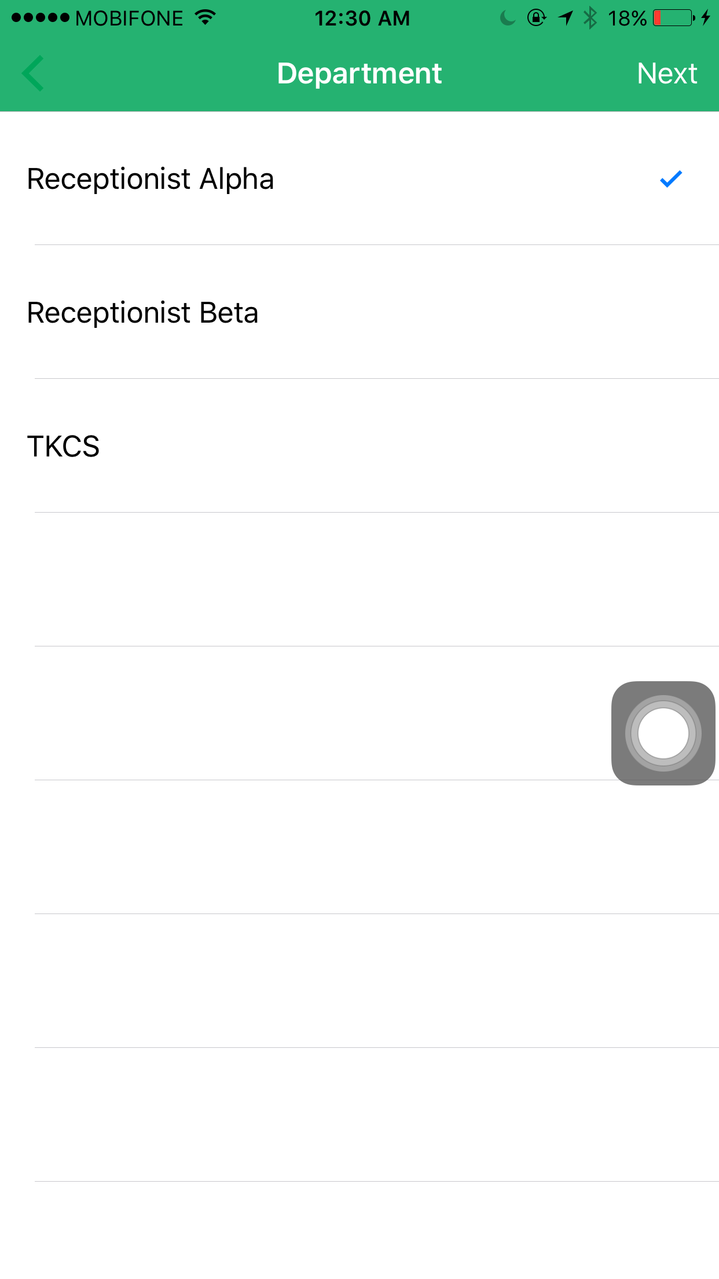
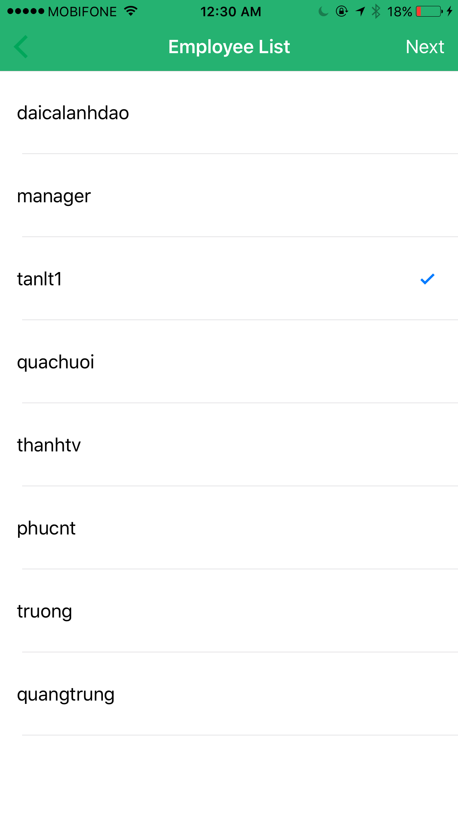
Algorithms – Training Employee Image - Process
Timekeeping
Pre-training
Training
1. Choose department
2. Choose employee
Admin
department_id
user_id
capture
Notes:
Ngày nay, hầu hết các công ty sử dụng việc quẹt thẻ từ ID để chấm công cho nhân viên

Slide 160
Algorithms – Training Employee Image - Process
Timekeeping
Pre-training
Training
TKCS
Department
Department
Code
user_id
Account
Admin
department_id
user_code
Notes:
Ngày nay, hầu hết các công ty sử dụng việc quẹt thẻ từ ID để chấm công cho nhân viên

Slide 161
Algorithms – Training Employee Image - Process
Timekeeping
Pre-training
Training
TKCS
Department
PersonGroup
Department
Code
groupCode
user_code
Account
Department
Code
Person
Admin
user_id
department_id
user_code
personCode
Notes:
Ngày nay, hầu hết các công ty sử dụng việc quẹt thẻ từ ID để chấm công cho nhân viên

Slide 162
Algorithms – Training Employee Image - Process
Timekeeping
Pre-training
Training
TKCS
Department
PersonGroup
Department
Code
groupCode
user_code
Account
Department
Code
Person
Admin
user_id
department_id
user_code
personCode
persistedFaceId
Face
Notes:
Ngày nay, hầu hết các công ty sử dụng việc quẹt thẻ từ ID để chấm công cho nhân viên

Slide 163
Algorithms – Training Employee Image - Process
Timekeeping
Pre-training
Training
TKCS
Department
PersonGroup
Department
Code
groupCode
user_code
Account
Department
Code
Person
Admin
user_id
department_id
user_code
personCode
persistedFaceId
Face
Face
faceId
Notes:
Ngày nay, hầu hết các công ty sử dụng việc quẹt thẻ từ ID để chấm công cho nhân viên

Slide 164
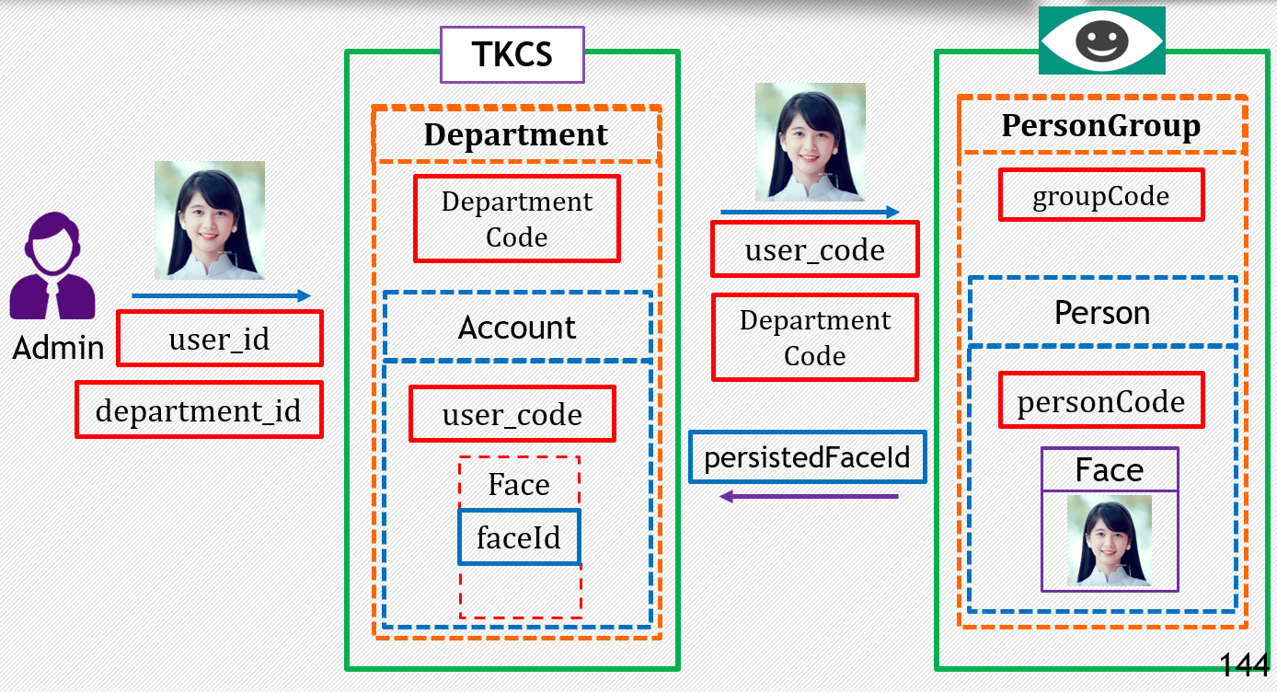
Algorithms – Training Employee Image - Process
Timekeeping
Pre-training
Training
Notes:
Ngày nay, hầu hết các công ty sử dụng việc quẹt thẻ từ ID để chấm công cho nhân viên

Slide 165

Algorithms – Training Employee Image - Process
Timekeeping
Pre-training
Training
5
At least 5 times
Notes:
Ngày nay, hầu hết các công ty sử dụng việc quẹt thẻ từ ID để chấm công cho nhân viên

Slide 166
Algorithms – Training Employee Image
Timekeeping
Preparation - Training
Training Process Image
Finish Training Process
Notes:
Ngày nay, hầu hết các công ty sử dụng việc quẹt thẻ từ ID để chấm công cho nhân viên

Slide 167
Algorithms – Training Employee Image - Finish
Timekeeping
Pre-training
Training
Finish
TKCS
Department
Department
Code
Admin
finish training
department_id
Notes:
Ngày nay, hầu hết các công ty sử dụng việc quẹt thẻ từ ID để chấm công cho nhân viên

Slide 168
Algorithms – Training Employee Image - Finish
Timekeeping
Pre-training
Training
Finish
TKCS
Department
Person
Department
Code
Admin
Call API Training
finish training
department_id
Notes:
Ngày nay, hầu hết các công ty sử dụng việc quẹt thẻ từ ID để chấm công cho nhân viên

Slide 169
Algorithms – Training Employee Image - Finish
Timekeeping
Pre-training
Training
Finish
TKCS
Department
Person
Department
Code
Admin
Call API Training
finish training
department_id
Response
Response
Notes:
Ngày nay, hầu hết các công ty sử dụng việc quẹt thẻ từ ID để chấm công cho nhân viên

Slide 170
Algorithms – Training Employee Image
Timekeeping
Preparation - Training
Training Process Image
Finish Training Process

Slide 171
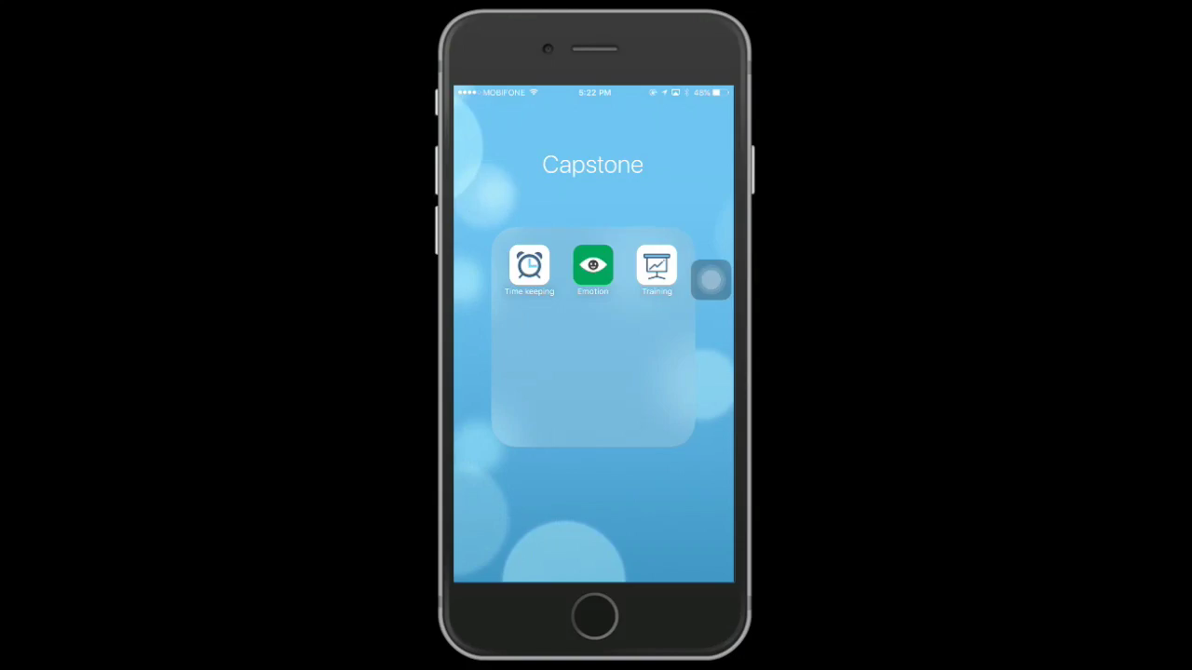
Demo – Training Employee Image
Timekeeping
Admin
use
training app
Mr.Tan (Newcomer)

Slide 172

Identifying Process
Timekeeping
Notes:
Sau khi đã xây dựng được bộ dữ liệu cho nhân viên, thì bây giờ nhân viên có thể bắt đầu điểm danh trong hệ thống.
Sau đây chúng tôi xin trình bày về quá trình xác định nhân viên trong hệ thống.

Slide 173
Algorithms – Check in
Timekeeping
Upload image
TKCS
Camera

Slide 174
Algorithms – Check in
Timekeeping
Upload image
TKCS
Detect face API
Camera

Slide 175
Algorithms – Check in
Timekeeping
Upload image
TKCS
Detect face API
Camera

Slide 176
Algorithms – Check in
Timekeeping
Upload image
TKCS
Detect face API
Camera

Slide 177

Algorithms – Check in
Timekeeping
Upload image
TKCS
Detect face API
Camera

Slide 178
Algorithms – Check in
Timekeeping
Upload image
TKCS
Detect face API
Camera
faceId

Slide 179
Algorithms – Check in
Timekeeping
Upload image
TKCS
faceId
Department 1
Camera
Department 2

Slide 180
Algorithms – Check in
Timekeeping
Upload image
TKCS
faceId
Person Group 1
Department 1
Person Group 2
Camera
Department 2

Slide 181
Algorithms – Check in
Timekeeping
Upload image
Identify person id
TKCS
faceId
faceId
Person Group 1
code
Department 1
code
Person Group 2
Camera
Identify API
Department 2

Slide 182

Algorithms – Check in
Timekeeping
Upload image
Identify person id
TKCS
faceId
faceId
Person Group 1
code
Department 1
faceId
code
Camera
Identify API
Person Group 2
Department 2

Slide 183
Algorithms – Check in
Timekeeping
Upload image
Identify person id
TKCS
faceId
faceId
Person Group 1
code
Face_1
Department 1
Face_2
in person group 1
code
Query face
Camera
Identify API
Face_3
...
Department 2
Face_n
Person Group 2

Slide 184
Algorithms – Check in
Timekeeping
Upload image
Identify person id
TKCS
faceId
faceId
Person Group 1
code
Face_1
in person group 1
Department 1
Face_2
code
Query face
Face_3
Camera
Identify API
...
Face_n
Department 2
Max similarity
Face
Person Group 2

Slide 185
Algorithms – Check in
Timekeeping
Upload image
Identify person id
TKCS
faceId
faceId
Person Group 1
code
Face_1
in person group 1
Department 1
Face_2
code
Query face
Face_3
Camera
Identify API
...
Face_n
Department 2
Max similarity
Face
Person
Person Group 2

Slide 186
Algorithms – Check in
Timekeeping
Upload image
Identify person id
TKCS
faceId
faceId
Person Group 1
code
Face_1
in person group 1
Department 1
Face_2
code
Query face
Face_3
Camera
Identify API
...
personId
Face_n
Department 2
confidence
Max similarity
Face
Person
Person Group 2

Slide 187
Algorithms – Check in
Timekeeping
Upload image
Identify person id
TKCS
faceId
faceId
Person Group 1
Confidence:
code
Face_1
in person group 1
Department 1
Is similarity between 2 faces
Range [0, 1]
Face_2
code
Query face
Face_3
Camera
Identify API
...
personId
Face_n
Department 2
confidence
Max similarity
Face
Person
Person Group 2

Slide 188

Algorithms – Check in
Timekeeping
Upload image
Identify person id
TKCS
faceId
faceId
Person Group 1
Confidence > 0.7
code
Face_1
in person group 1
Department 1
faceId
Why??
Face_2
code
Query face
Face_3
Identify API
Identify API
Camera
...
Camera
personId
personId
Face_n
Department 2
confidence
Max similarity
Face
Person
Person Group 2

Slide 189
Algorithms – Check in
Timekeeping
Upload image
Identify person id
TKCS
faceId
faceId
Person Group 1
Confidence > 0.7
code
Face_1
in person group 1
Department 1
faceId
Face_2
0
0.01
0.1
0.55
Query face
0.95
code
Identify API
0.65
Face_3
Identify API
Camera
...
Camera
Different
personId
personId
Face_n
Department 2
In family
Same person
confidence
Max similarity
Face
Person
Person Group 2

Slide 190
Algorithms – Check in
Timekeeping
Upload image
Identify person id
TKCS
faceId
faceId
Person Group 1
Confidence > 0.7
code
Face_1
in person group 1
Department 1
faceId
Face_2
0
0.01
0.1
0.55
Query face
0.95
code
Identify API
0.65
Face_3
Identify API
Camera
...
Camera
Different
personId
personId
Face_n
Department 2
In family
Same person
confidence
Max similarity
Face
Person
Person Group 2

Slide 191
Algorithms – Check in
Timekeeping
Upload image
Identify person id
TKCS
faceId
Person Group 1
faceId
personId
code
Face_1
in person group 1
Department 1
confidence
Face_2
code
Query face
Face_3
Camera
Identify API
...
personId
Face_n
Department 2
confidence
Max similarity
Face
Person
Person Group 2

Slide 192
Algorithms – Check in
Timekeeping
Upload image
Identify person id
TKCS
faceId
Person Group 1
faceId
personId
code
Face_1
in person group 1
Department 1
confidence
Face_2
code
Query face
Face_3
Camera
Identify API
...
personId
Face_n
Department 2
confidence
Max similarity
Face
Person
Person Group 2

Slide 193
Algorithms – Check in
Timekeeping
Upload image
Identify person id
TKCS
faceId
Person Group 1
faceId
personId
code
Face_1
in person group 1
Department 1
confidence < 0.7
Face_2
code
Query face
Face_3
Camera
Identify API
...
personId
Face_n
Department 2
confidence
Max similarity
Face
Person
Person Group 2

Slide 194
Algorithms – Check in
Timekeeping
Upload image
Identify person id
TKCS
faceId
faceId
Person Group 1
code
Department 1
Finish
Camera
Identify API
Person Group 2
Department 2
code
faceId

Slide 195

Algorithms – Check in
Timekeeping
Upload image
Identify person id
TKCS
faceId
faceId
Person Group 1
Department Code
Finish
Camera
Identify API
personId
Person Group 2
confidence
faceId

Slide 196
Algorithms – Check in
Timekeeping
Upload image
Identify person id
TKCS
faceId
faceId
Person Group 1
Department Code
Finish
confidence
> 0.7
Camera
Identify API
personId
Person Group 2
confidence
faceId

Slide 197
Algorithms – Check in
Timekeeping
Upload image
Identify person id
Identify employee
TKCS
faceId
faceId
Person Group 1
Department Code
Finish
Camera
Identify API
personId
Person Group 2
confidence
Finish

Slide 198
Algorithms – Check in
Timekeeping
Upload image
Identify person id
Identify employee
TKCS
faceId
faceId
Person Group 1
Department Code
Account
Finish
Camera
Identify API
user_code
personId
Person Group 2
confidence
Finish

Slide 199
Algorithms – Check in
Timekeeping
Upload image
Identify person id
Identify employee
TKCS
faceId
faceId
Person Group 1
Department Code
Account
Finish
user_code
Camera
Identify API
personId
Person Group 2
confidence
Finish

Slide 200

Algorithms – Check in
Timekeeping
Upload image
Identify person id
Identify employee
Timekeeping
TKCS
faceId
faceId
Person Group 1
Department Code
Account
Finish
Timekeeping
Camera
Identify API
time_check
personId
Person Group 2
confidence
Finish

Slide 201

Algorithms – Check in
Timekeeping
Upload image
Identify person id
Identify employee
Timekeeping
TKCS
faceId
faceId
Person Group 1
Department Code
Account
Finish
Timekeeping
Camera
Identify API
time_check
personId
Person Group 2
Notify
confidence
Finish
Employee App

Slide 202
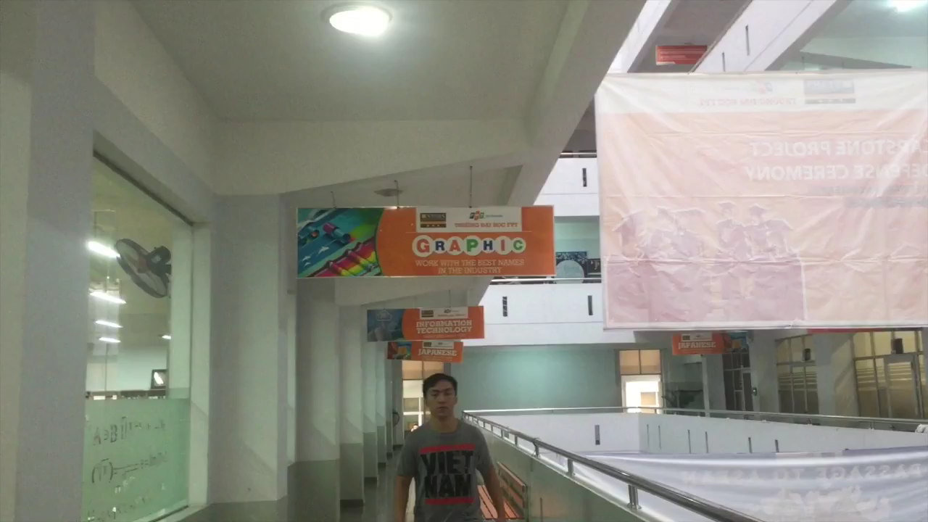
Demo – Check in
Timekeeping

Slide 203
Reminder Message

Slide 204
Problem
Reminder Message
Scenario
Create meeting
10:00 Room 101
Mr.Hien (Manager)
Notes:
Vì khách hàng phàn nàn về chất lượng dịch vụ ở bộ phận do anh hiển quản lý → anh hiển mở cuộc họp khẩn cấp lúc 11h, tại phòng 107.
Anh hiển gửi mail cho tất cả thành viên trong phòng để thông báo cuộc họp.
Nhưng ko may, phòng 107 bị hư, nên phòng họp đc đổi sang 205.
Anh hiển lại gửi mail thông báo đổi phòng cho các thành viên về viec đổi phòng.
Anh Tân là nv dưới sự quản lý của a Hiển.
Hôm nay, a tân có buổi làm việc bên ngoài.
Sau khi kết thúc công việc, a Tân về công ty để tham gia cuộc họp. Nhưng vì quên ktra mail nên a tân đã tới phòng 107.
Lúc này a Tân mới biết phòng họp đổi sang 205.
➔ mất thời gian để tìm phòng họp

Slide 205
Problem
Reminder Message
Scenario
Create meeting
10:00 Room 101
Mr.Hien (Manager)
Send mail
Participants
Notes:
Vì khách hàng phàn nàn về chất lượng dịch vụ ở bộ phận do anh hiển quản lý → anh hiển mở cuộc họp khẩn cấp lúc 11h, tại phòng 107.
Anh hiển gửi mail cho tất cả thành viên trong phòng để thông báo cuộc họp.
Nhưng ko may, phòng 107 bị hư, nên phòng họp đc đổi sang 205.
Anh hiển lại gửi mail thông báo đổi phòng cho các thành viên về viec đổi phòng.
Anh Tân là nv dưới sự quản lý của a Hiển.
Hôm nay, a tân có buổi làm việc bên ngoài.
Sau khi kết thúc công việc, a Tân về công ty để tham gia cuộc họp. Nhưng vì quên ktra mail nên a tân đã tới phòng 107.
Lúc này a Tân mới biết phòng họp đổi sang 205.
➔ mất thời gian để tìm phòng họp

Slide 206
Problem
Reminder Message
Scenario
Create meeting
10:00 Room 101
Unfortunately
Room 101 is damaged
Mr.Hien (Manager)
Send mail
Participants
Notes:
Vì khách hàng phàn nàn về chất lượng dịch vụ ở bộ phận do anh hiển quản lý → anh hiển mở cuộc họp khẩn cấp lúc 11h, tại phòng 107.
Anh hiển gửi mail cho tất cả thành viên trong phòng để thông báo cuộc họp.
Nhưng ko may, phòng 107 bị hư, nên phòng họp đc đổi sang 205.
Anh hiển lại gửi mail thông báo đổi phòng cho các thành viên về viec đổi phòng.
Anh Tân là nv dưới sự quản lý của a Hiển.
Hôm nay, a tân có buổi làm việc bên ngoài.
Sau khi kết thúc công việc, a Tân về công ty để tham gia cuộc họp. Nhưng vì quên ktra mail nên a tân đã tới phòng 107.
Lúc này a Tân mới biết phòng họp đổi sang 205.
➔ mất thời gian để tìm phòng họp

Slide 207
Problem
Reminder Message
Scenario
Create meeting
Change to
10:00 Room 101
Unfortunately
Room 101 is damaged
10:00 Room 207
Mr.Hien (Manager)
Send mail
Participants
Notes:
Vì khách hàng phàn nàn về chất lượng dịch vụ ở bộ phận do anh hiển quản lý → anh hiển mở cuộc họp khẩn cấp lúc 11h, tại phòng 107.
Anh hiển gửi mail cho tất cả thành viên trong phòng để thông báo cuộc họp.
Nhưng ko may, phòng 107 bị hư, nên phòng họp đc đổi sang 205.
Anh hiển lại gửi mail thông báo đổi phòng cho các thành viên về viec đổi phòng.
Anh Tân là nv dưới sự quản lý của a Hiển.
Hôm nay, a tân có buổi làm việc bên ngoài.
Sau khi kết thúc công việc, a Tân về công ty để tham gia cuộc họp. Nhưng vì quên ktra mail nên a tân đã tới phòng 107.
Lúc này a Tân mới biết phòng họp đổi sang 205.
➔ mất thời gian để tìm phòng họp

Slide 208
Problem
Reminder Message
Scenario
Create meeting
Change to
10:00 Room 101
Unfortunately
Room 101 is damaged
10:00 Room 207
Mr.Hien (Manager)
Send mail
Send mail
Participants
Notes:
Vì khách hàng phàn nàn về chất lượng dịch vụ ở bộ phận do anh hiển quản lý → anh hiển mở cuộc họp khẩn cấp lúc 11h, tại phòng 107.
Anh hiển gửi mail cho tất cả thành viên trong phòng để thông báo cuộc họp.
Nhưng ko may, phòng 107 bị hư, nên phòng họp đc đổi sang 205.
Anh hiển lại gửi mail thông báo đổi phòng cho các thành viên về viec đổi phòng.
Anh Tân là nv dưới sự quản lý của a Hiển.
Hôm nay, a tân có buổi làm việc bên ngoài.
Sau khi kết thúc công việc, a Tân về công ty để tham gia cuộc họp. Nhưng vì quên ktra mail nên a tân đã tới phòng 107.
Lúc này a Tân mới biết phòng họp đổi sang 205.
➔ mất thời gian để tìm phòng họp

Slide 209
Problem
Reminder Message
Scenario
Create meeting
Change to
10:00 Room 101
Unfortunately
Room 101 is damaged
10:00 Room 207
Mr.Hien (Manager)
Send mail
Send mail
Participants
work
Outdoor
Mr.Tan (Employee)
Notes:
Vì khách hàng phàn nàn về chất lượng dịch vụ ở bộ phận do anh hiển quản lý → anh hiển mở cuộc họp khẩn cấp lúc 11h, tại phòng 107.
Anh hiển gửi mail cho tất cả thành viên trong phòng để thông báo cuộc họp.
Nhưng ko may, phòng 107 bị hư, nên phòng họp đc đổi sang 205.
Anh hiển lại gửi mail thông báo đổi phòng cho các thành viên về viec đổi phòng.
Anh Tân là nv dưới sự quản lý của a Hiển.
Hôm nay, a tân có buổi làm việc bên ngoài.
Sau khi kết thúc công việc, a Tân về công ty để tham gia cuộc họp. Nhưng vì quên ktra mail nên a tân đã tới phòng 107.
Lúc này a Tân mới biết phòng họp đổi sang 205.
➔ mất thời gian để tìm phòng họp

Slide 210

Problem
Reminder Message
Scenario
Create meeting
Change to
10:00 Room 101
Unfortunately
Room 101 is damaged
10:00 Room 207
Mr.Hien (Manager)
Send mail
Send mail
Participants
work
Go to
Outdoor
Mr.Tan (Employee)
Notes:
Vì khách hàng phàn nàn về chất lượng dịch vụ ở bộ phận do anh hiển quản lý → anh hiển mở cuộc họp khẩn cấp lúc 11h, tại phòng 107.
Anh hiển gửi mail cho tất cả thành viên trong phòng để thông báo cuộc họp.
Nhưng ko may, phòng 107 bị hư, nên phòng họp đc đổi sang 205.
Anh hiển lại gửi mail thông báo đổi phòng cho các thành viên về viec đổi phòng.
Anh Tân là nv dưới sự quản lý của a Hiển.
Hôm nay, a tân có buổi làm việc bên ngoài.
Sau khi kết thúc công việc, a Tân về công ty để tham gia cuộc họp. Nhưng vì quên ktra mail nên a tân đã tới phòng 107.
Lúc này a Tân mới biết phòng họp đổi sang 205.
➔ mất thời gian để tìm phòng họp

Slide 211
Problem
Reminder Message
Scenario
Create meeting
Change to
10:00 Room 101
Unfortunately
Room 101 is damaged
10:00 Room 207
Mr.Hien (Manager)
Send mail
Send mail
Participants
Forget to check
work
Go to
Outdoor
Email
Mr.Tan (Employee)
Notes:
Vì khách hàng phàn nàn về chất lượng dịch vụ ở bộ phận do anh hiển quản lý → anh hiển mở cuộc họp khẩn cấp lúc 11h, tại phòng 107.
Anh hiển gửi mail cho tất cả thành viên trong phòng để thông báo cuộc họp.
Nhưng ko may, phòng 107 bị hư, nên phòng họp đc đổi sang 205.
Anh hiển lại gửi mail thông báo đổi phòng cho các thành viên về viec đổi phòng.
Anh Tân là nv dưới sự quản lý của a Hiển.
Hôm nay, a tân có buổi làm việc bên ngoài.
Sau khi kết thúc công việc, a Tân về công ty để tham gia cuộc họp. Nhưng vì quên ktra mail nên a tân đã tới phòng 107.
Lúc này a Tân mới biết phòng họp đổi sang 205.
➔ mất thời gian để tìm phòng họp

Slide 212
Problem
Reminder Message
Scenario
Create meeting
Change to
10:00 Room 101
Unfortunately
Room 101 is damaged
10:00 Room 207
Mr.Hien (Manager)
Send mail
Send mail
Participants
Forget to check
work
Go to
Go to
Room 101
Outdoor
Email
Mr.Tan (Employee)
Notes:
Vì khách hàng phàn nàn về chất lượng dịch vụ ở bộ phận do anh hiển quản lý → anh hiển mở cuộc họp khẩn cấp lúc 11h, tại phòng 107.
Anh hiển gửi mail cho tất cả thành viên trong phòng để thông báo cuộc họp.
Nhưng ko may, phòng 107 bị hư, nên phòng họp đc đổi sang 205.
Anh hiển lại gửi mail thông báo đổi phòng cho các thành viên về viec đổi phòng.
Anh Tân là nv dưới sự quản lý của a Hiển.
Hôm nay, a tân có buổi làm việc bên ngoài.
Sau khi kết thúc công việc, a Tân về công ty để tham gia cuộc họp. Nhưng vì quên ktra mail nên a tân đã tới phòng 107.
Lúc này a Tân mới biết phòng họp đổi sang 205.
➔ mất thời gian để tìm phòng họp

Slide 213
Problem
Reminder Message
Scenario
Create meeting
Change to
10:00 Room 101
Unfortunately
Room 101 is damaged
10:00 Room 207
Mr.Hien (Manager)
Send mail
Send mail
Participants
Forget to check
work
Go to
Go to
Room 101
Outdoor
Email
Mr.Tan (Employee)
!!!Know that room had been changed
Notes:
Vì khách hàng phàn nàn về chất lượng dịch vụ ở bộ phận do anh hiển quản lý → anh hiển mở cuộc họp khẩn cấp lúc 11h, tại phòng 107.
Anh hiển gửi mail cho tất cả thành viên trong phòng để thông báo cuộc họp.
Nhưng ko may, phòng 107 bị hư, nên phòng họp đc đổi sang 205.
Anh hiển lại gửi mail thông báo đổi phòng cho các thành viên về viec đổi phòng.
Anh Tân là nv dưới sự quản lý của a Hiển.
Hôm nay, a tân có buổi làm việc bên ngoài.
Sau khi kết thúc công việc, a Tân về công ty để tham gia cuộc họp. Nhưng vì quên ktra mail nên a tân đã tới phòng 107.
Lúc này a Tân mới biết phòng họp đổi sang 205.
➔ mất thời gian để tìm phòng họp

Slide 214
Problem
Reminder Message
Scenario
Create meeting
Change to
Waste of time to find room
10:00 Room 101
Unfortunately
Room 101 is damaged
10:00 Room 207
Mr.Hien (Manager)
Send mail
Send mail
Participants
Forget to check
work
Go to
Go to
Room 101
Outdoor
Email
Mr.Tan (Employee)
!!!Know that room had been changed
Notes:
Vì khách hàng phàn nàn về chất lượng dịch vụ ở bộ phận do anh hiển quản lý → anh hiển mở cuộc họp khẩn cấp lúc 11h, tại phòng 107.
Anh hiển gửi mail cho tất cả thành viên trong phòng để thông báo cuộc họp.
Nhưng ko may, phòng 107 bị hư, nên phòng họp đc đổi sang 205.
Anh hiển lại gửi mail thông báo đổi phòng cho các thành viên về viec đổi phòng.
Anh Tân là nv dưới sự quản lý của a Hiển.
Hôm nay, a tân có buổi làm việc bên ngoài.
Sau khi kết thúc công việc, a Tân về công ty để tham gia cuộc họp. Nhưng vì quên ktra mail nên a tân đã tới phòng 107.
Lúc này a Tân mới biết phòng họp đổi sang 205.
➔ mất thời gian để tìm phòng họp

Slide 215
Our Proposal
Reminder Message
System
Notes:
Giải pháp chúng tôi đưa ra như sau: với hệ thống chấm công mà chúng tôi đã trình bày trước đó, chúng tôi đã xây dựng thêm chức năng nhắc nhở cho nhân viên khi thời gian và phòng họp bị thay đổi → từ đó nv sẽ không tốn nhiều thời gian để tìm phòng họp

Slide 216
Our Proposal
Reminder Message
Support to notify reminder
System
Notes:
Giải pháp chúng tôi đưa ra như sau: với hệ thống chấm công mà chúng tôi đã trình bày trước đó, chúng tôi đã xây dựng thêm chức năng nhắc nhở cho nhân viên khi thời gian và phòng họp bị thay đổi → từ đó nv sẽ không tốn nhiều thời gian để tìm phòng họp

Slide 217
Our Proposal
Reminder Message
Support to notify reminder
System
Save time for finding room
Notes:
Giải pháp chúng tôi đưa ra như sau: với hệ thống chấm công mà chúng tôi đã trình bày trước đó, chúng tôi đã xây dựng thêm chức năng nhắc nhở cho nhân viên khi thời gian và phòng họp bị thay đổi → từ đó nv sẽ không tốn nhiều thời gian để tìm phòng họp

Slide 218
How we do that?
Reminder Message
How??
Notes:
Làm sao chúng tôi làm đc điều đó

Slide 219

How we do that?
Reminder Message
Mobile App
System
Cloud Message

Slide 220

How we do that?
Reminder Message
1.Go to Website
Manager

Slide 221
How we do that?
Reminder Message
Reminder Message
1.Go to Website
2.Create/Update reminder message
Manager

Slide 222
How we do that?
Reminder Message
Reminder Message
1.Go to Website
2.Create/Update reminder message
Manager
System
3.Send request
Cloud Message

Slide 223
How we do that?
Reminder Message
Reminder Message
1.Go to Website
2.Create/Update reminder message
Manager
System
3.Send request
4.Notify
Mobile App for Employee
Cloud Message

Slide 224
Technical
Reminder Message
Notify for employee
Cloud Message

Slide 225
Demo
Reminder Message
Scenario
Create meeting
15:00 Room 101
Mr.Hien
Notify
Participants

Slide 226
Demo
Reminder Message
Scenario
Create meeting
15:00 Room 101
Unfortunately
Room 101 is damaged
Change to
Room 205
Mr.Hien
Notify
Notify
Participants

Slide 227
Indoor Direction
Notes:
Ngoài các chức năng chính được giới thiệu ở trên. Thì chúng tôi cũng cung cấp thêm chức năng chỉ đường vào phòng họp dành cho nhân viên mới

Slide 228

Problem
Indoor Direction
Scenario
Complex, difficult to remember
TTH bank map

Slide 229
Problem
Indoor Direction
Scenario
Complex, difficult to remember
TTH bank map
Mr.Tan (Newcomer)

Slide 230
Problem
Indoor Direction
Scenario
Complex, difficult to remember
TTH bank map
Diffculty in finding room
Mr.Tan (Newcomer)

Slide 231
Problem
Indoor Direction
Scenario
Diffculty in finding room
Complex, difficult to remember
TTH bank map
Diffculty in finding room
Mr.Tan (Newcomer)

Slide 232
Our Proposal
Indoor Direction
System

Slide 233
Our Proposal
Indoor Direction
Support to make direction
System

Slide 234
Our Proposal
Indoor Direction
Support to make direction
System
New employee can easily to find room

Slide 235
How’d we do that?
Indoor Direction
How??

Slide 236

How’d we do that?
Indoor Direction
Mobile App
System
Beacon

Slide 237
How’d we do that?
Indoor Direction
Mobile App
System
Beacon
Get indoor direction

Slide 238
How’d we do that?
Indoor Direction
Mobile App
System
Beacon
Identify employee location and make indoor direction
Get indoor direction

Slide 239
How’d we do that?
Indoor Direction
Mobile App
System
Beacon
Identify employee location and make indoor direction
Get indoor direction
Send signal to mobile

Slide 240
How’d we do that?
Indoor Direction
Indoor Direction
Employee

Slide 241
How’d we do that?
Indoor Direction
Indoor Direction
1.Direction
Employee
Mobile App for Employee

Slide 242
How’d we do that?
Indoor Direction
Indoor Direction
1.Direction
Employee
Mobile App for Employee
Receive Beacon’s Signal
Beacon
Notes:
Sau nv nhận được thông báo, đối với nv mới, họ ko biết đường, họ sẽ chọn direction để chỉ đường.
Mobile app nhận tín hiệu của beacon để xđ vtri của nv.
Sau khi mobile xđ vtri, mobile gửi yo cầu cho ht.
Ht gửi kq về cho mobile.
Mobile hiện chỉ dẫn cho nv.

Slide 243
How’d we do that?
Indoor Direction
Indoor Direction
2.Identify Location
1.Direction
Employee
Mobile App for Employee
Receive Beacon’s Signal
Beacon
Notes:
Sau nv nhận được thông báo, đối với nv mới, họ ko biết đường, họ sẽ chọn direction để chỉ đường.
Mobile app nhận tín hiệu của beacon để xđ vtri của nv.
Sau khi mobile xđ vtri, mobile gửi yo cầu cho ht.
Ht gửi kq về cho mobile.
Mobile hiện chỉ dẫn cho nv.

Slide 244
How’d we do that?
Indoor Direction
Indoor Direction
2.Identify Location
1.Direction
3.Send request
Employee
Mobile App for Employee
System
Receive Beacon’s Signal
Beacon
Notes:
Sau nv nhận được thông báo, đối với nv mới, họ ko biết đường, họ sẽ chọn direction để chỉ đường.
Mobile app nhận tín hiệu của beacon để xđ vtri của nv.
Sau khi mobile xđ vtri, mobile gửi yo cầu cho ht.
Ht gửi kq về cho mobile.
Mobile hiện chỉ dẫn cho nv.

Slide 245
How’d we do that?
Indoor Direction
Indoor Direction
2.Identify Location
1.Direction
3.Send request
Employee
Mobile App for Employee
4.Response
System
Receive Beacon’s Signal
Beacon
Notes:
Sau nv nhận được thông báo, đối với nv mới, họ ko biết đường, họ sẽ chọn direction để chỉ đường.
Mobile app nhận tín hiệu của beacon để xđ vtri của nv.
Sau khi mobile xđ vtri, mobile gửi yo cầu cho ht.
Ht gửi kq về cho mobile.
Mobile hiện chỉ dẫn cho nv.

Slide 246
Technical
Indoor Direction
Identify employees location
Beacon

Slide 247
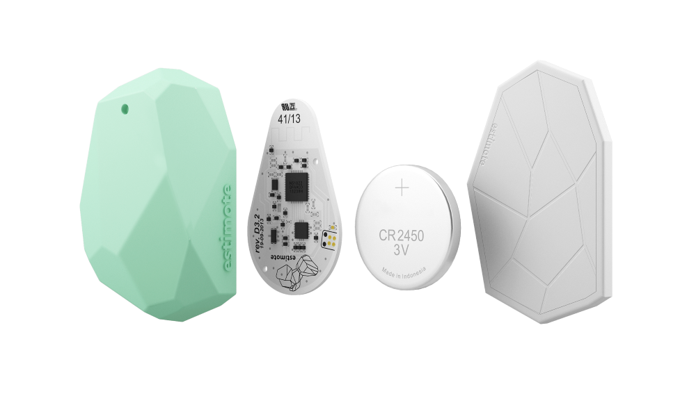
Technical
Indoor Direction
Introduction Beacon
Estimote Beacons are tiny computers.
Equipped with Bluetooth Smart module, temperature and motion sensor,they broadcast radio signals through built-in antennas.
Notes:
Sau đây, tôi xin giới hiệu sơ qua về công nghệ beacon.
Beacon có thể xem như 1 máy tính thu nhỏ.
Nó được trang bị bluetooth, có cảm biến nhiệt và chuyển động.
Ngoài ra, beacon còn đc tích hợp ăng-ten để có thể phát sóng

Slide 248
Algorithms – Indoor direction
Indoor Direction

Slide 249
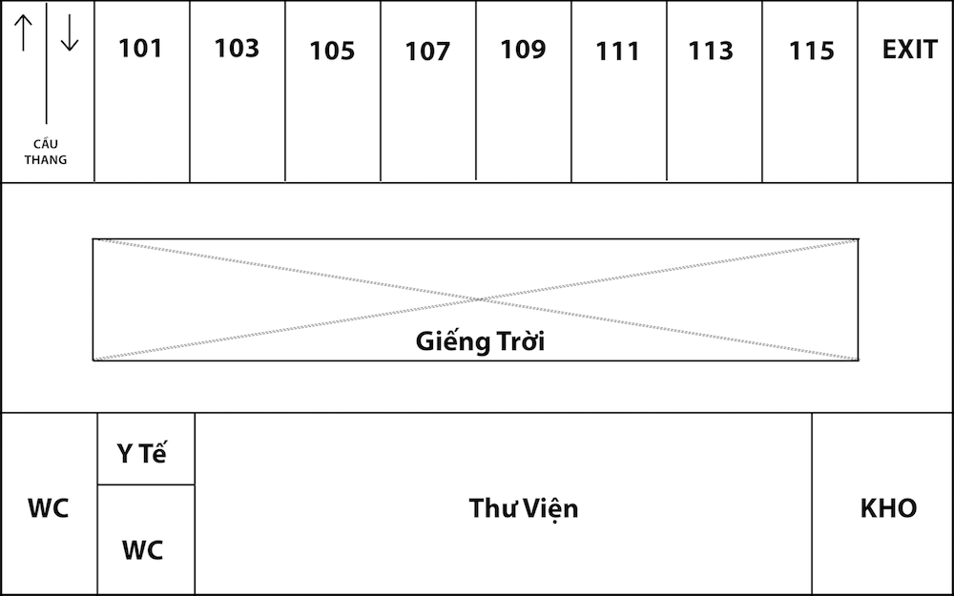
Algorithms – Indoor direction
Indoor Direction

Slide 250
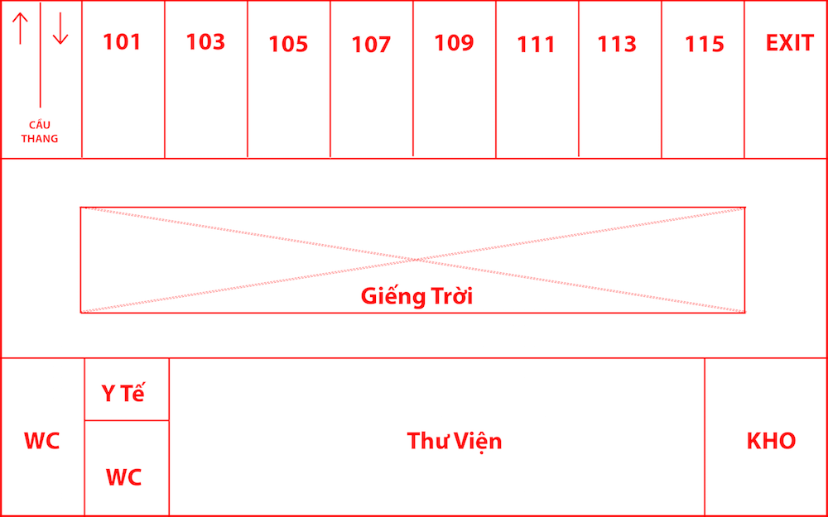
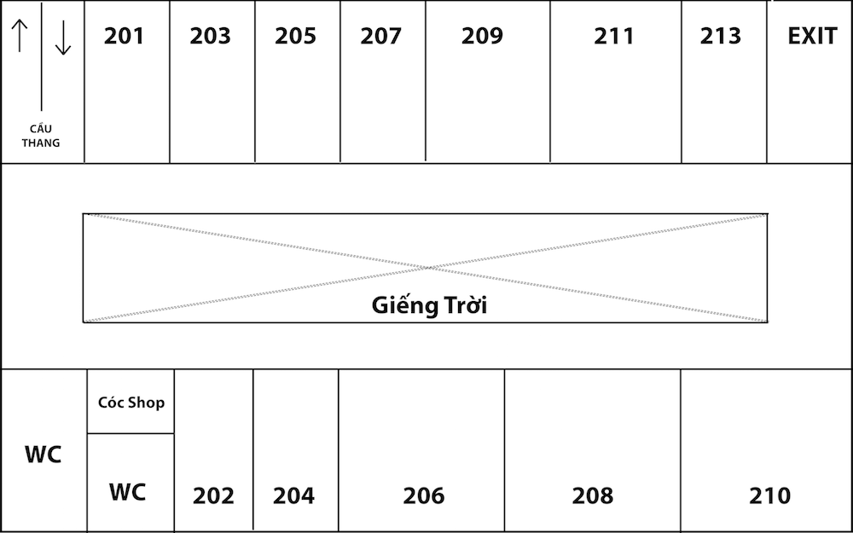
Algorithms – Indoor direction
Indoor Direction

Slide 251
Algorithms – Indoor direction
Indoor Direction

Slide 252
Algorithms – Indoor direction
Indoor Direction

Slide 253
Algorithms – Indoor direction
Indoor Direction
Outline

Slide 254
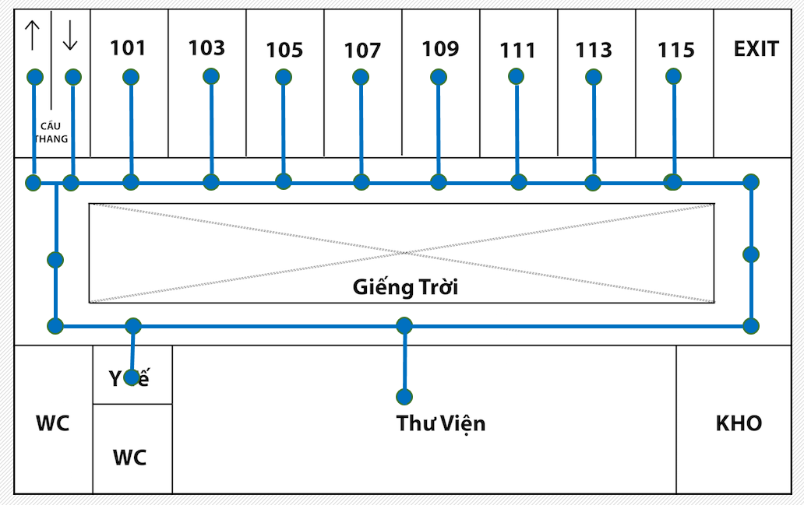
Algorithms – Indoor direction
Indoor Direction
Outline
Create graph

Slide 255
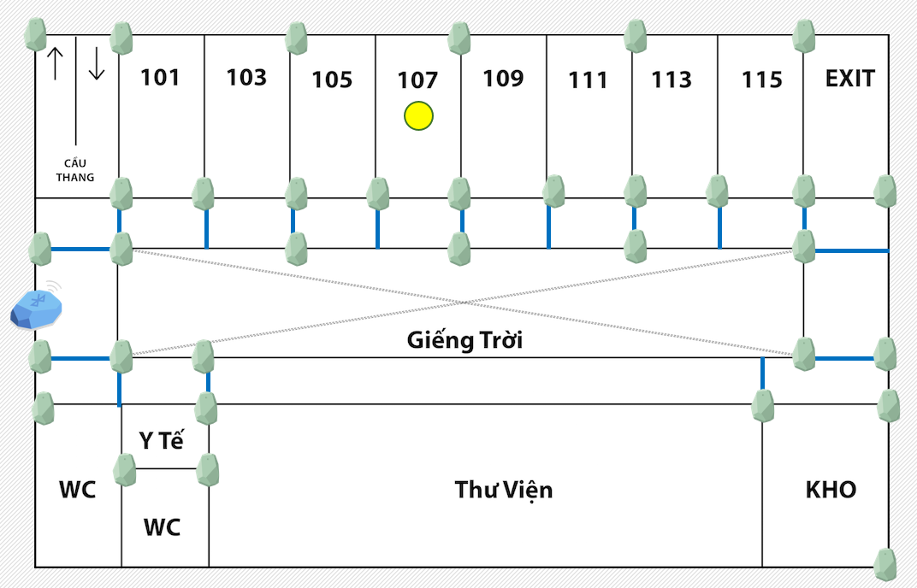
Algorithms – Indoor direction
Indoor Direction
Outline
Create graph
Identify location in map

Slide 256
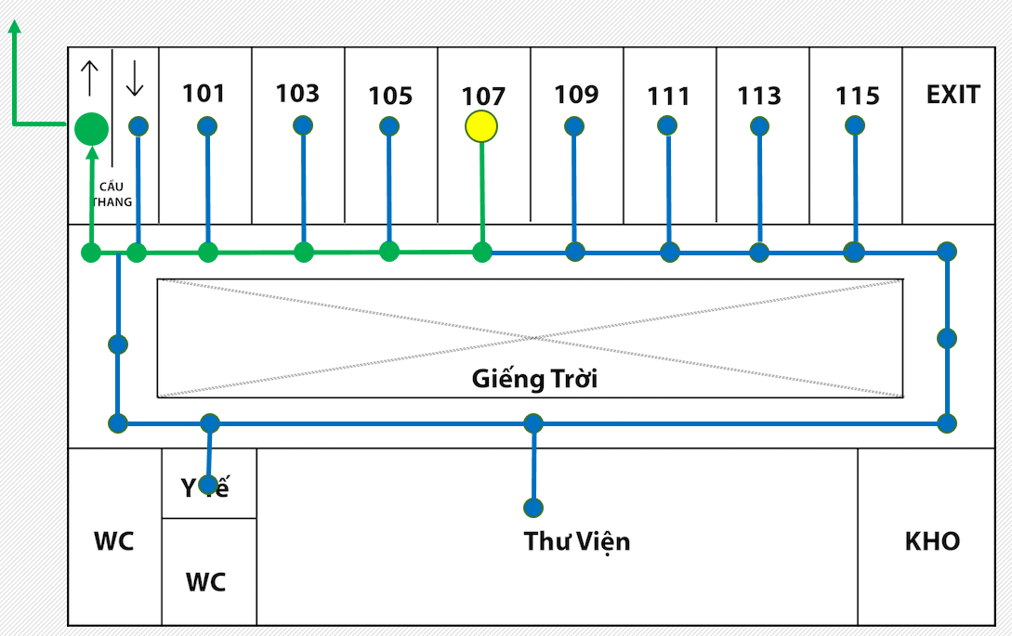
Algorithms – Indoor direction
Indoor Direction
Create graph
Identify location in map
Apply Dijkstra's algorithms to find shortest path.

Slide 257
Algorithms – Indoor direction
Indoor Direction
Preparation
Direction
Identify location
Identify floor

Slide 258
Algorithms – Indoor direction
Indoor Direction
Preparation

Slide 259
Algorithms – Indoor direction – Preparation
Indoor Direction
Preparation
Divide map to Areas

Slide 260
Algorithms – Indoor direction – Preparation
Indoor Direction
Preparation
Room
Area

Slide 261
Algorithms – Indoor direction – Preparation
Indoor Direction
Preparation
Room
Area
Outside Room

Slide 262
Algorithms – Indoor direction – Preparation
Indoor Direction
Preparation

Slide 263
Algorithms – Indoor direction – Preparation
Indoor Direction
Preparation

Slide 264
Algorithms – Indoor direction – Preparation
Indoor Direction
Preparation

Slide 265
Algorithms – Indoor direction
Indoor Direction
Preparation
Direction
Identify location
Identify floor

Slide 266
Algorithms – Indoor direction – Identify floor
Indoor Direction
Preparation
Identify floor

Slide 267
Algorithms – Indoor direction – Identify floor
Indoor Direction
Preparation
Identify floor
Floor
Beacon

Slide 268
Algorithms – Indoor direction – Identify floor
Indoor Direction
Preparation
Identify floor
Floor 3
Floor 2
Floor 1

Slide 269

Algorithms – Indoor direction – Identify floor
Indoor Direction
Preparation
Identify floor
Floor 3
C
Floor
Beacon
Floor 2
B
Floor 1
A

Slide 270
Algorithms – Indoor direction – Identify floor
Indoor Direction
Preparation
Identify floor
Floor 3
C
Floor
Beacon
Floor 2
B
Floor 1
A
S

Slide 271
Algorithms – Indoor direction – Identify floor
Indoor Direction
Preparation
Identify floor
Floor 3
C
Floor
Beacon
Floor 2
B
Floor 1
A
S

Slide 272
Algorithms – Indoor direction – Identify floor
Indoor Direction
Preparation
Identify floor
Floor 3
SA : distance from S to A
SB : distance from S to B
SC : distance from S to C
C
Floor
Beacon
Floor 2
B
Floor 1
A
S

Slide 273
Algorithms – Indoor direction – Identify floor
Indoor Direction
Preparation
Identify floor
Floor 3
SA : distance from S to A
SB : distance from S to B
SC : distance from S to C
C
Floor
Beacon
Floor 2
30m
B
25m
Floor 1
20m
A
S

Slide 274
Algorithms – Indoor direction – Identify floor
Indoor Direction
Preparation
Identify floor
Floor 3
SA : distance from S to A
SB : distance from S to B
SC : distance from S to C
C
Floor
Beacon
Floor 2
30m
B
25m
SA is minimum
Floor 1
20m
A
S

Slide 275
Algorithms – Indoor direction – Identify floor
Indoor Direction
Preparation
Identify floor
Floor 3
SA : distance from S to A
SB : distance from S to B
SC : distance from S to C
C
Floor
Beacon
Floor 2
30m
B
25m
SA is minimum
Floor 1
20m
A
S
Floor 1

Slide 276
Algorithms – Indoor direction
Indoor Direction
Preparation
Direction
Identify location
Identify floor

Slide 277
Algorithms – Indoor direction – Identify floor
Indoor Direction
Preparation
Identify floor
Area

Slide 278
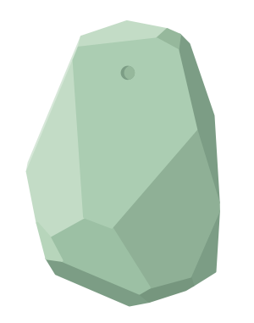
Algorithms – Indoor direction – Identify location
Indoor Direction
Preparation
Identify floor
Identify location
Beacon
Floor

Slide 279
Algorithms – Indoor direction – Identify location
Indoor Direction
Preparation
Identify floor
Identify location
Beacon
Floor

Slide 280
Algorithms – Indoor direction – Identify location
Indoor Direction
Preparation
Identify floor
Identify location

Slide 281
Algorithms – Indoor direction – Identify location
Indoor Direction
Preparation
Identify floor
Identify location

Slide 282
Algorithms – Indoor direction – Identify location
Indoor Direction
Preparation
Identify floor
Identify location

Slide 283
Algorithms – Indoor direction – Identify location
Indoor Direction
Preparation
Identify floor
Identify location

Slide 284
Algorithms – Indoor direction – Identify location
Indoor Direction
Preparation
Identify floor
Identify location

Slide 285
Algorithms – Indoor direction – Identify location
Indoor Direction
Preparation
Identify floor
Identify location

Slide 286
Algorithms – Indoor direction – Identify location
Indoor Direction
Preparation
Identify floor
Identify location

Slide 287
Algorithms – Indoor direction – Identify location
Indoor Direction
Preparation
Identify floor
Identify location
Beacon
Floor

Slide 288
Algorithms – Indoor direction
Indoor Direction
Preparation
Direction
Identify location
Identify floor

Slide 289
Algorithms – Indoor direction – Direction
Indoor Direction
Preparation
Identify floor
Identify location
Direction

Slide 290
Algorithms – Indoor direction – Direction
Indoor Direction
Preparation
Identify floor
Identify location
Direction

Slide 291
Algorithms – Indoor direction – Direction
Indoor Direction
Preparation
Identify floor
Identify location
Direction
Dijkstra's algorithms

Slide 292
Algorithms – Indoor direction – Direction
Indoor Direction
Preparation
Identify floor
Identify location
Direction
Dijkstra's algorithms
start

Slide 293
Algorithms – Indoor direction – Direction
Indoor Direction
Preparation
Identify floor
Identify location
Direction
Dijkstra's algorithms
start
Vertex

Slide 294
Algorithms – Indoor direction – Direction
Indoor Direction
Preparation
Identify floor
Identify location
Direction
Dijkstra's algorithms
start
Vertex
Edge

Slide 295
Algorithms – Indoor direction – Direction
Indoor Direction
Preparation
Identify floor
Identify location
Direction
Dijkstra's algorithms
start
6.5
Weight
Vertex
Edge

Slide 296
Algorithms – Indoor direction – Direction
Indoor Direction
Preparation
Identify floor
Identify location
Direction

Slide 297
Algorithms – Indoor direction – Direction
Indoor Direction
Preparation
Identify floor
Identify location
Direction

Slide 298
Algorithms – Indoor direction
Indoor Direction
Preparation
Direction
Identify location
Identify floor

Slide 299
Algorithms – Indoor direction – Identify location
Reminder Message
2
0
x
y

Slide 300
Algorithms – Indoor direction – Identify location
Reminder Message
2
0
x
y
x
y

Slide 301
Algorithms – Indoor direction – Identify location
Reminder Message
2
0
x
y
x
(x, y)
y

Slide 302
Algorithms – Indoor direction – Identify location
Reminder Message
2
0
x
y

Slide 303
Algorithms – Indoor direction – Identify location
Reminder Message
2
0
x
B (x2, y2)
A (x1, y1)
C (x3, y3)
y

Slide 304
Algorithms – Indoor direction – Identify location
Reminder Message
2
0
x
B (x2, y2)
A (x1, y1)
C (x3, y3)
y

Slide 305
Algorithms – Indoor direction – Identify location
Reminder Message
2
0
x
B (x2, y2)
A (x1, y1)
S (x, y)
C (x3, y3)
y

Slide 306
Algorithms – Indoor direction – Identify location
Reminder Message
2
0
x
B (x2, y2)
A (x1, y1)
d1
d2
(x, y)
d3
C (x3, y3)
y

Slide 307
Algorithms – Indoor direction – Identify location
Reminder Message
2
0
x
$$\sqrt{{(x_{1}−x)}^{2}+ {(y_{1}−y)}^{2}}=d$$
B (x2, y2)
A (x1, y1)
d1
d2
(x, y)
d3
C (x3, y3)
y

Slide 308
Algorithms – Indoor direction – Identify location
Reminder Message
2
$d_{1}= \sqrt{{\left(x_{1}−x\right)}^{2}+ {\left(y_{1}−y\right)}^{2}}$ (I)
$d_{2}=\sqrt{{\left(x_{2}−x\right)}^{2}+ {\left(y_{2}−y\right)}^{2}}$ (II)
$d_{3}=\sqrt{{\left(x_{3}−x\right)}^{2}+ {\left(y_{3}−y\right)}^{2}}$ (II)
$$2\left(x_{2}− x_{1}\right)x+2\left(y_{b}− y_{1}\right)y= {d_{1}}^{2}− {d_{2}}^{2}+ {x_{2}}^{2}− {x_{1}}^{2}+ {y_{2}}^{2}− {y_{1}}^{2}$$
$$2\left(x_{3}− x_{1}\right)x+2\left(y_{3}− y_{1}\right)y= {d_{1}}^{2}− {d_{3}}^{2}+ {x_{3}}^{2}− {x_{1}}^{2}+ {y_{3}}^{2}− {y_{1}}^{2}$$

Slide 309
Algorithms – Indoor direction – Identify location
Reminder Message
2
$$Dx=({d_{1}}^{2}− {d_{2}}^{2}+ {x_{2}}^{2}− {x_{1}}^{2}+ {y_{2}}^{2}− {y_{1}}^{2})∗\left(y_{3}− y_{1}\right)−({d_{1}}^{2}− {d_{3}}^{2}+ {x_{3}}^{2}− {x_{1}}^{2}+ {y_{3}}^{2}− {y_{1}}^{2})∗\left(y_{2}− y_{1}\right)$$
$$Dy= {{(d}_{1}}^{2}− {d_{2}}^{2}+ {x_{2}}^{2}− {x_{1}}^{2}+ {y_{2}}^{2}− {y_{1}}^{2})∗\left(x_{2}− x_{1}\right)−({d_{1}}^{2}− {d_{2}}^{2}+ {x_{2}}^{2}− {x_{1}}^{2}+ {y_{2}}^{2}− {y_{1}}^{2})∗\left(x_{3}− x_{1}\right)x_{1}$$
$$D= 2\left(x_{2}− x_{1}\right)∗\left(y_{3}− y_{1}\right)− 2\left(x_{3}− x_{1}\right)∗\left(x_{b2}− x_{b1}\right)$$
$$x$$ | Dx / D
$$y$$ | Dy / D

Slide 310
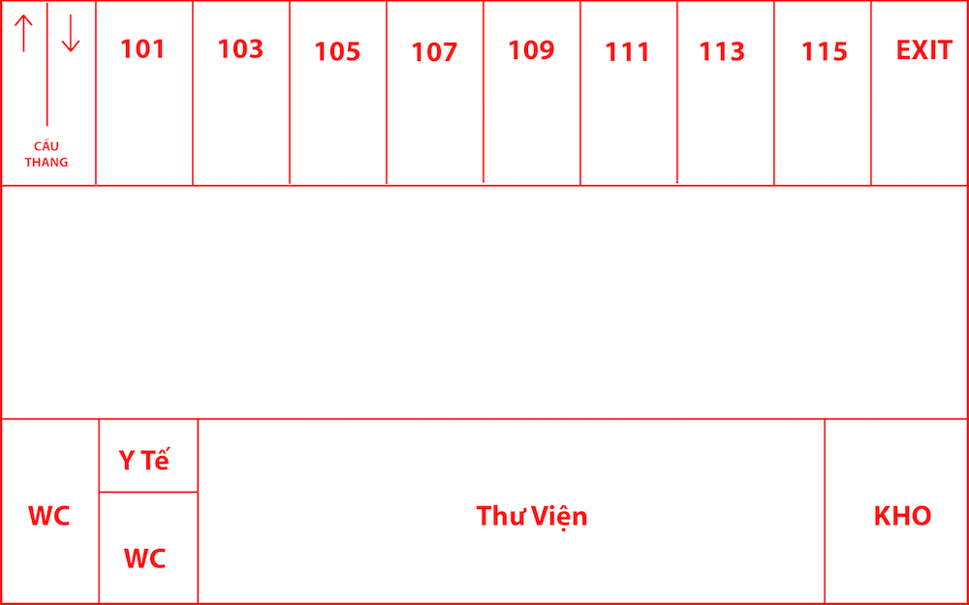
Algorithms – Indoor direction – Identify location
Reminder Message
2
0
x
y

Slide 311
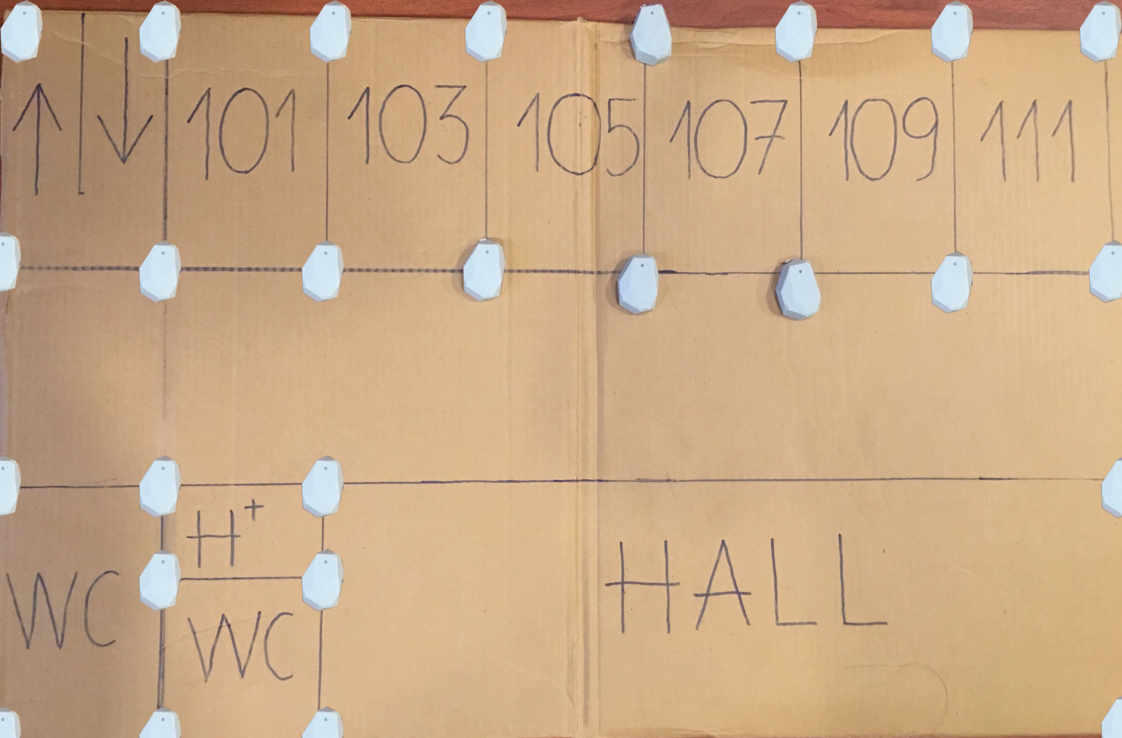
Algorithms – Indoor direction
Reminder Message
Beacon
Floor

Slide 312
Algorithms – Indoor direction
Reminder Message
A
B
Beacon
Floor
C

Slide 313
Algorithms – Indoor direction
Reminder Message
A
B
Beacon
Floor
C

Slide 314
Algorithms – Indoor direction
Reminder Message
A
B
Beacon
Floor
C

Slide 315
Algorithms – Indoor direction
Reminder Message
A
B
Beacon
Floor
C

Slide 316
Algorithms – Indoor direction
Reminder Message
A
B
Beacon
Floor
C

Slide 317
Algorithms – Indoor direction
Reminder Message
A
B
Beacon
Floor
C

Slide 318
Algorithms – Indoor direction
Reminder Message
A
B
Beacon
Floor
C

Slide 319
Algorithms – Indoor direction
Reminder Message
Identify floor
Direction
Identify location

Slide 320
Algorithms – Indoor direction - Direction
Reminder Message
3

Slide 321
Algorithms – Indoor direction - Direction
Reminder Message
3

Slide 322
Algorithms – Indoor direction - Direction
Reminder Message
3

Slide 323
Algorithms – Indoor direction - Direction
Reminder Message
3

Slide 324
Algorithms – Indoor direction - Direction
Reminder Message
3

Slide 325
Algorithms – Indoor direction - Direction
Reminder Message
3

Slide 326
Algorithms – Indoor direction - Direction
Reminder Message
3

Slide 327
Algorithms – Indoor direction - Direction
Reminder Message
3

Slide 328
Algorithms – Indoor direction - Direction
Reminder Message
3

Slide 329
Algorithms – Indoor direction - Direction
Reminder Message
3
Apply
Dijkstra’

Slide 330
Direction
0
x
x
(x1,y1)
Vertex
y
y

Slide 331
Direction
0
x
(x2, y2)
(x1, y1)
y

Slide 332
Direction
0
x
(x2, y2)
edge
(x1, y1)
y

Slide 333
Demo – Indoor Direction
Indoor Direction
Scenario
Receive notification
Meeting room at 205
use
Mr.Tan (Newcomer)
Mobile App for Employee
Current location: 107
ROOM: 107
Bàn hội đồng

Slide 334
Outcome and limit

Slide 335
TKCS
Outcome
✓ Filter and mining data to suitable for Vietnamese
✓ Suggest emotion message for employees
✓ Suggest suitable behavior for employees
1. Customer Emotion
✓ Manager can evaluate employees performance

Slide 336
TKCS
Outcome
✓ Built employees data
✓ Check-in by camera
✓ Auto notify reminder message
2. Timekeeping
✓ Identify employee location in the building
✓ Indoor direction

Slide 337
TKCS
Limit - we don’t rest on our laurels
✘ Suggestion message is not nice
✘ Suggestion behavior is not diversity
✘Using basic techniques mining
✘ Emotion recognize still not fast
1. Customer Emotion

Slide 338
TKCS
Limit - we don’t rest on our laurels
✘ Facial recognize still not fast
✘Cannot identify twins
2. Timekeeping

Slide 339
Future plan

Slide 340
TKCS
Future plan – Customer Emotion
1. Emotion recognize by video.
3. Send image
1. Record video
4. Response Emotion
Microsoft Cognitive
Services
Camera
System
Face
2. Image Processing
5.Processing

Slide 341


TKCS
Future plan – Timekeeping
Reminder Message
System
iOS Smartphone
Android Smartphone

Slide 342
Thanks for listening

